Slide 1
Monitoring – Indicators and Tools

Slide 2
Monitoring – Why, What and How?
Implementation of strategic actions on company level need monitoring of performance and success
Gives ongoing (formative) information about performance and achievement of strategic goals
Allows for steering, corrections and adaptation of actions if necessary
Allows for stopping the implementation of strategies if necessary
Prevents bad surprises in the end
Is part of the strategic P-D-C-A circle for strategy implementation

Slide 3
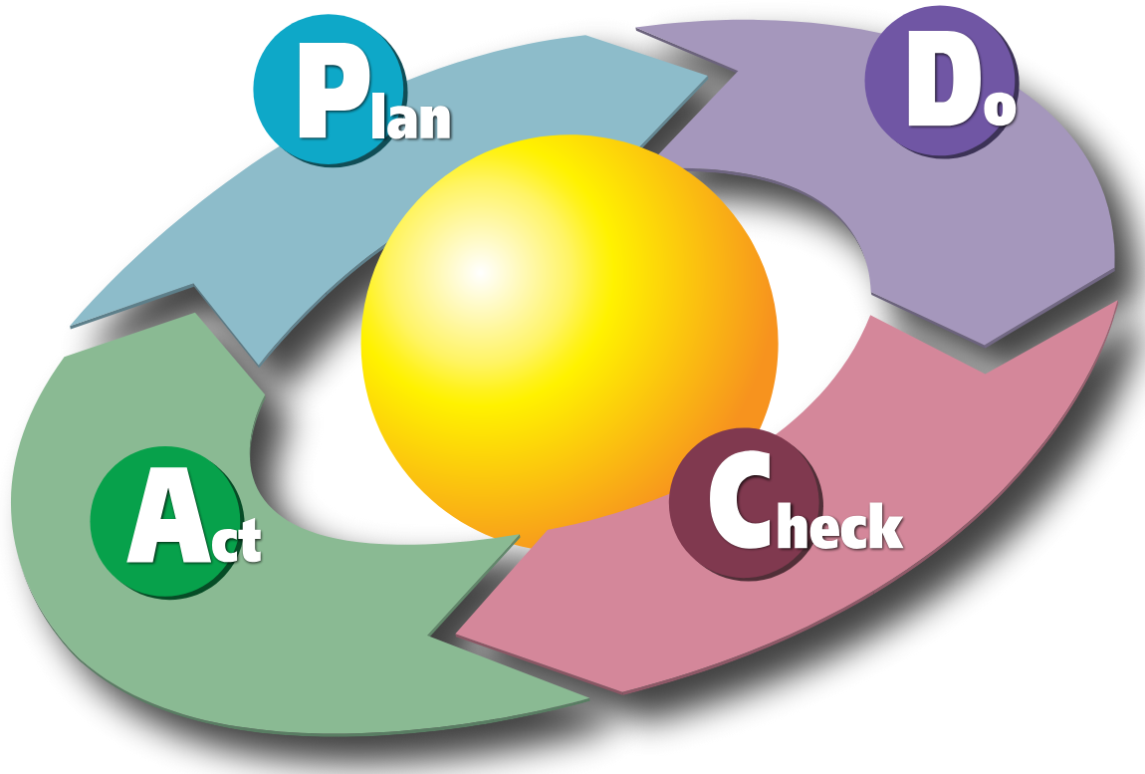
Monitoring – Why, What and How?
MONITORING
By Karn-b - Karn Bulsuk (http://www.bulsuk.com

Slide 4
Monitoring – Why, What and How?
Monitoring – CHECK is all about:
to verify whether the plan is working as intended and to generate insights that guide improvements in the Act phase
Without proper monitoring and evaluation, it is unclear if your strategy and actions are targeted, reach the planned outcomes or are at risk to fail.
Without proper monitoring the PDCA circle is NOT working

Slide 5
Monitoring – Why, What and How?
Key activities in the monitoring phase of your strategy are:
Collect data and results from the „Do“ phase (measuring key performance indicators KPI‘s, metrics or observation)
Compare the actual results to the plan (variance or deviation analysis)
Analyse discrepancies or deviations in detail
Deduct actions, steering mechanisms and documentation for the next phase „Act“.

Slide 6
Monitoring – Why, What and How?
Which methods and tools may be used for monitoring and deviation analysis?
KPI‘s – Key Performance Indicators
Employee Surveys and Feedback Systems
Performance appraisal systems (e.g. 360 degree Feedback)
External (also internal) audits
Benchmarking
Observation and managerial reports
Many others…

Slide 7
Monitoring – Why, What and How?
Important selection criteria:
Criterion | Description | Why It Matters
1. Relevance | The method should measure what truly matters to business goals (e.g., employee turnover, time-to-hire). | Avoids collecting “nice-to-know” but irrelevant data.
2. Simplicity & Ease of Use | Easy for managers or HR staff to apply regularly without specialized training. | Small teams can sustain it long-term.
3. Cost-Effectiveness | Minimal cost in tools, software, or time. | Keeps overhead low for small businesses.
4. Data Reliability | Data collected should be accurate and consistent. | Prevents misleading decisions.
5. Frequency & Timeliness | Ability to monitor at appropriate intervals (monthly, quarterly). | Enables quick corrective actions.
6. Integration & Automation | Compatibility with existing systems (like payroll or HR software). | Reduces manual work and errors.
7. Actionability | The method should produce results that lead to clear actions or improvements. | Ensures monitoring leads to impact, not just reporting.

Slide 8
Monitoring – Why, What and How?
Possible monitoring tools:
KPI‘s – Key Performance Indicators
HR metrics and statistics
Qualitative surveys

Slide 9
Monitoring – Why, What and How?
Key Performance Indicators:
Key Performance Indicators (KPIs) in Human Resources (HR) are measurable values that help organizations track and evaluate the effectiveness and efficiency of their HR processes. They connect HR activities to business outcomes and help identify areas for improvement.
For your monitoring of increasing full time employment of women in your company, possible KPI’s could be:

Slide 10
KPI | Description | Why It Matters
% of Female Applicants | Share of female applicants among total applicants for full-time roles. | Measures gender diversity in candidate pipeline.
% of Female Candidates Shortlisted | Female share at the interview stage. | Evaluates potential bias in screening.
% of Female Hires (Full-Time) | Female hires divided by total full-time hires. | Tracks hiring conversion success.
Gender Diversity by Role Level | Female representation by job grade or function. | Identifies underrepresented areas.
Gender Balance in Talent Pool Sources | % of women from job boards, referrals, etc. | Optimizes recruitment channels.

Slide 11
KPI | Description | Why It Matters
% of Female Promotions (Full-Time) | Proportion of full-time promotions going to women. | Monitors gender equity in advancement.
Female Representation in Leadership Roles | % of women in management or senior positions. | Shows progress in upper-level inclusion.
Training Participation (Female Full-Time Employees) | % of full-time women attending leadership or skill programs. | Tracks access to development opportunities.
Flexible Work Policy Adoption | % of female full-time employees using flexible or hybrid options. | Indicates policy effectiveness.
Parental Leave Utilization (Female) | % of eligible women using maternity/parental leave. | Reflects confidence in work-life balance policies.
Return-to-Work Rate (Post-Leave) | % of women returning to full-time work after maternity/parental leave. | Measures re-entry support effectiveness.

Slide 12
Monitoring – Why, What and How?
Strategic / long-term KPIs could be:
Gender Parity Index (Full-Time) – Ratio of women to men in full-time roles.
Benchmark Comparison – Female full-time employment rate vs. industry / sector average.
Target Female Full-Time Employment Growth (%) – e.g., “Increase from 35% to 45% by 2026.”

Slide 13
Monitoring – Why, What and How?
For your monitoring of keeping senior workers longer in your company, possible KPI’s could be:
KPI | Definition | Purpose
Average Employee Age | Mean age of workforce. | Monitors workforce aging trends.
% of Employees Aged 50+ (or 55+) | Employees aged 50+/55+ ÷ total employees × 100. | Measures representation of experienced staff.
Retention Rate of 50+ Employees | (Employees aged 50+ who remain in company ÷ total 50+ employees at start of period) × 100. | Key indicator for retention success.
Turnover Rate (50+ Employees) | (Number of 50+ employees who leave ÷ total 50+ employees) × 100. | Identifies potential attrition issues.
Average Tenure of Employees 50+ | Average years of service of 50+ employees. | Reflects longevity and commitment.
Exit Rate Due to Retirement | % of total exits caused by retirement. | Helps anticipate workforce planning needs.

Slide 14
KPI | Definition | Purpose
% of Older Employees in Mentorship Roles | (Number of 50+ employees mentoring others ÷ total 50+ employees) × 100. | Tracks active knowledge sharing.
Mentorship Program Participation Rate | (Employees involved in intergenerational mentoring ÷ total eligible employees) × 100. | Evaluates program reach.
Success Rate of Knowledge Transfer Initiatives | % of departments with completed succession or handover plans. | Ensures organizational knowledge continuity.
Engagement Score (50+ Employees) | Survey-based engagement index for older employees. | Core measure of motivation and belonging.
Absenteeism Rate (50+ Employees) | (Total absence days ÷ total available workdays for 50+ employees) × 100. | Reflects health and morale.
Health & Wellness Program Participation (50+) | % of 50+ employees using wellness initiatives. | Gauges health-support effectiveness.
Retirement Readiness Satisfaction | Survey score on confidence in transitioning into flexible or phased retirement. | Tracks perceptions of career security.

Slide 15
KPI | Definition | Purpose
% of 50+ Employees on Flexible or Part-Time Contracts | Measures uptake of alternative work arrangements. | Indicates company’s adaptability to aging workforce.
Internal Mobility Rate (50+) | % of older employees moving to new roles or reassignments. | Tracks opportunities for continued engagement.
Retention Rate Post-Flexibility Implementation | Retention of older employees who use flexible work options. | Evaluates impact of such policies.
% of Projects with Senior Expert Involvement | Share of strategic projects involving 50+ employees. | Measures knowledge utilization.
Productivity per Employee (50+) | Revenue or output generated per older employee. | Demonstrates contribution to performance.
Mentorship Satisfaction (Younger Employees) | Survey score on perceived value of mentorship from experienced staff. | Captures cross-generational value creation.

Slide 16
Monitoring – Why, What and How?
For your monitoring of exploiting the potentials of migrants and diversity for skilled work in your company, possible KPI’s could be:
KPI | Definition | Purpose
% of Migrant Employees | Number of migrant workers ÷ total workforce × 100 | Tracks overall representation.
Diversity Index | Weighted score measuring variety in nationality, ethnicity, gender, etc. | Monitors overall diversity levels.
% of Migrant Employees by Job Level | Representation across junior, mid, and senior roles | Identifies barriers to advancement.
Diversity Hiring Rate | % of new hires from migrant or underrepresented backgrounds | Evaluates recruitment inclusivity.
Retention Rate of Migrant Employees | Migrant employees retained ÷ total migrant employees | Ensures engagement and inclusion efforts are effective.

Slide 17
KPI | Definition | Purpose
% of Migrant Applicants | Migrant applicants ÷ total applicants × 100 | Tracks diversity in the talent pipeline.
% of Migrant Candidates Shortlisted | Migrants making it past initial screening ÷ total shortlisted | Monitors potential selection bias.
% of Migrant Hires | Migrant hires ÷ total hires × 100 | Measures recruitment success.
Time to Hire for Migrant Candidates | Average time from application to hire | Ensures fair and efficient hiring processes.
Source Effectiveness | % of hires from migrant-focused recruitment channels | Optimises outreach channels.
Training Participation Rate (Migrant Employees) | % of migrant employees attending internal training | Monitors access to skill-building opportunities.
Upskilling/Certification Completion Rate | % of migrant employees completing upskilling programs | Measures capability growth.
Post-Training Performance Improvement | % improvement in performance or productivity | Demonstrates learning impact.
Mentorship Program Participation | % of migrant employees in mentorship programs | Supports career development and potential realization.

Slide 18
KPI | Definition | Purpose
Promotion Rate of Migrant Employees | % of migrant employees promoted ÷ total promotions | Tracks advancement opportunities.
Internal Mobility Rate | % of migrant employees moving to new roles or projects | Measures access to career growth.
Leadership Representation | % of migrant employees in managerial/senior positions | Evaluates inclusivity in decision-making roles.
Salary Equity Ratio | Average migrant employee salary ÷ average comparable employee salary | Ensures fair compensation.
Project/Team Diversity Score | Diversity index of teams or project groups | Encourages inclusive collaboration.
Retention of High-Potential Migrant Employees | Retained high-performers ÷ total high-potential migrant staff | Monitors ability to retain talent with growth potential.
Participation in Company-Wide Initiatives | % of migrant employees in cross-functional programs | Indicates integration into core business operations.
Employee Recognition/ Awards | % of migrant employees receiving internal awards | Highlights visibility and acknowledgment of contributions.

Slide 19
Monitoring – Why, What and How?
For your monitoring of raising the potentials of upskilling unskilled workers in your company, possible KPI’s could be:
KPI | Definition | Purpose
Training Participation Rate | % of low-skilled employees participating in upskilling programs | Measures engagement and access to learning opportunities
Training Completion Rate | % of participants completing assigned courses or programs | Monitors follow-through and commitment
Average Learning Hours per Employee | Total training hours ÷ number of participants | Measures intensity of skill development
Certification / Qualification Achievement Rate | % of participants obtaining new skills or certifications | Tracks tangible outcomes of training
Upskilling Progress Rate | % of employees advancing from low-skilled to target skill level | Measures overall program effectiveness

Slide 20
KPI | Definition | Purpose
Pre- vs. Post-Training Performance Score | Average productivity/performance rating before and after upskilling | Quantifies skill improvement impact
Error Rate Reduction | Reduction in errors or rework after training | Measures quality improvements from upskilling
Task Competency Achievement | % of trained employees able to perform tasks independently | Shows practical skill application
Revenue/Output per Upskilled Employee | Contribution to output per employee | Tracks tangible business impact
Promotion Rate of Upskilled Employees | % of low-skilled employees promoted after upskilling | Tracks career advancement
Internal Mobility Rate | % of upskilled employees moving to higher-skilled roles | Measures effectiveness in creating new opportunities
Salary Increase / Pay Upgrade Rate | % of employees receiving pay adjustments after upskilling | Shows financial recognition of enhanced capability
Retention Rate of Upskilled Employees | Retention of employees who completed upskilling programs | Evaluates loyalty and engagement

Slide 21
KPI | Definition | Purpose
Cost per Upskilled Employee | Total investment ÷ number of participants | Monitors training efficiency
Time to Competency | Average time for employees to reach target skill level | Measures program speed and effectiveness
Skill Coverage Rate | % of identified low-skilled workforce covered by upskilling programs | Ensures scale of initiative
Business Impact ROI | (Revenue/Cost benefit from upskilling ÷ training cost) × 100 | Quantifies financial return of HR development

Slide 22
Monitoring – Why, What and How?
Selecting, defining and operating with Key Performance indicators:
Choose 3-5 KPI‘s per target group / section (observe selection criteria)
Define the target values at the end of the strategy implementation for each KPI
Define the measurement points and time frame for each KPI
Insert these data into a KPI dashboard

Slide 23

Monitoring – Why, What and How?
KPI Monitoring Dashboard

Slide 24
Monitoring – Why, What and How?
5) Implement the monitoring activities periodically according to the plans in the monitoring dashboard
6) Detect variations and deviations, mark negative deviations with a traffic light system
7) For yellow or red indicators, develop modification or adaptation measures to keep your KPIs on track
8) At the end of the monitoring process, document achieved KPIs and possible deviations for deduction of new actions and measures in the sense of closing the P-D-C-A circle

Slide 25
Monitoring – Why, What and How?

Slide 26
THANK YOU

