Slide 1









WP5 - Strategy Workshop - Part 1
Turning Potential into Action
WKO
Funded by the European Union. Views and opinions expressed are however those of the author(s) only and do not necessarily reflect those of the European Union or OeAD-GmbH. Neither the European Union nor the granting authority can be held responsible for them.Project N° 2023-1-AT01-KA220-VET-000152934

Slide 2


WP5
Content
  Introduction and goals of the workshop
  Overview of the Business Model Canvas
  Brainstorming and Identification of barriers & resources
  Individual Business Model Canvas
  Presentation of Individual Business Model Canvas
  Group discussion and Feedback
  Sharing insights & wrap-up

Slide 3

WP5
We are here today to:
  Reflect on your own company’s situation by identifying internal barriers and opportunities related to the target group (female workers).
  Use the Business Model Canvas (BMC) as a structured tool to transform ideas into strategic actions.
  Collaboratively develop and refine strategies that can be implemented and further developed.
  Learn from peers through feedback and exchange.
  Lay the foundation for sustainable change, which will be continued in the upcoming Monitoring Unit where we will focus on implementation and progress tracking.

Slide 4

WP5
The Business Model Canvas
  Strategic tool to visualize how an organization creates, delivers & captures value (Osterwalder & Pigneur, 2010)【Source: Osterwalder, A., & Pigneur, Y. (2010). Business Model Generation. Wiley】
  Adapted here for HR & workforce strategy
Today we focus on the following target group:
Women

Slide 5


WP5
Brainstorming & Identification of Barriers & Resources
Think about barriers (obstacles preventing integration of target groups)
Think about resources (existing strengths/assets in your company)
Group Exercise- Instructions:
  Each participant writes 1–3 barriers on individual Post-its.
  Repeat for resources.
  Stick them on the flipchart/board (two columns: “Barriers” & “Resources”).
  Briefly cluster and discuss main themes as a group.

Slide 6
WP5
Individual Business Modell Canvas
Individual Work
Fill out your personal BMC with focus on your target group.
Target Group – Women - Define their needs/barriers.
Value Offers – What could your company offer this group? (e.g., flexible hours, mentoring)
Channels – How to reach them? (e.g., job portals, community networks)
Relationships – What relationship should be established? (e.g., supportive onboarding, mentorship)
Value for the Company – What benefits will this bring? (e.g., reduced turnover, new talent pool)
Key Resources – What resources do you already have? (e.g., HR staff, training budget)
Key Activities – What must be done? (e.g., revise job ads, create mentoring program)
Key Partners – Who could help? (e.g., training providers, local employment agencies)
Cost Structure – What will it cost? (money, time, staff capacity)

Slide 7
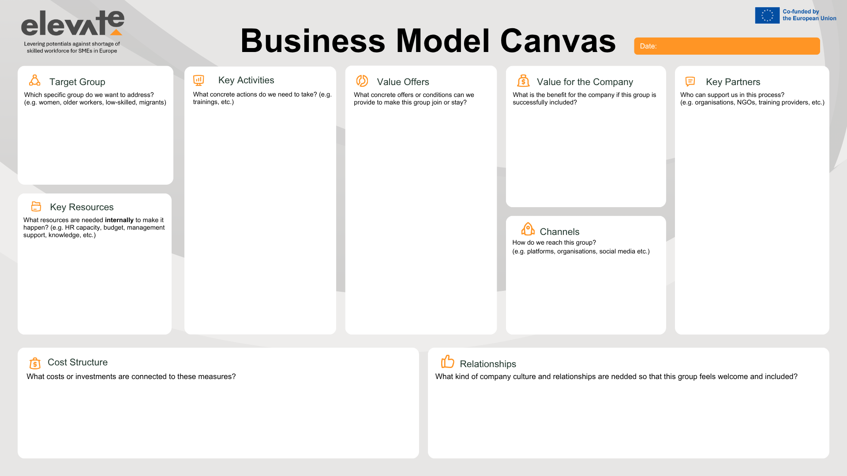
WP5

Slide 8



WP5
Presentation of Individual Business Model Canvas
Present your individual Business Model Canvas
Provide and receive constructive peer feedback
Identify strengths and areas for improvement regarding strategies for the four target groups

Slide 9

WP5
Feedback Guidelines
After each presentation, peers provide feedback in 3 steps:
  1. Strengths – What works well in the Canvas?
  2. Improvement areas – Where is clarification or adjustment needed?
  3. Suggestions – What could make this strategy stronger or more realistic?
Principles for Constructive Feedback
  Respectful listening: allow each participant to present without interruption
  Feedback must be constructive, specific, and actionable
Notes:
Trainer collects feedback on PPT/Flipchart and saves results for participants

Slide 10

WP5
Canvas Presentations
  Each participant presents their individual Canvas (5 minutes max.)
  Focus on key ideas, not every detail

Slide 11


WP5
Wrap up and Outlook
“What was your key takeaway or ‘aha moment’ from today’s session?”

Slide 12
THANK YOU
Funded by the European Union. Views and opinions expressed are however those of the author(s) only and do not necessarily reflect those of the European Union or OeAD-GmbH. Neither the European Union nor the granting authority can be held responsible for them. Project N° 2023-1-AT01-KA220-VET-000152934

