Slide 1
General Information on upskilling, best practice, management & leadership approaches
UNIT 20

Slide 2
THE INVISIBLE POTENTIAL: REINVENTING TALENT
Introduction
Situation and challenges of low-skilled adults
Opportunities and keys for improvement
Experiences and good practices
Strategic recommendations
Conclusion

Slide 3

THE INVISIBLE POTENTIAL: REINVENTING TALENT
INTRODUCTION
¿Cul-de-sac...
or WASTED POTENTIAL?

Slide 4
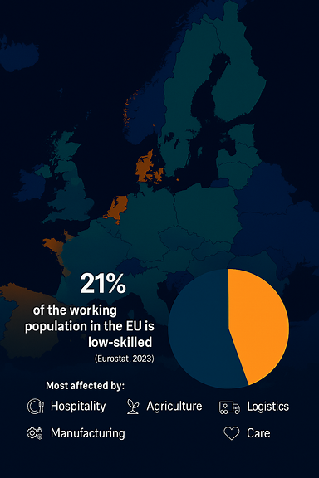
THE INVISIBLE POTENTIAL: REINVENTING TALENT
INTRODUCTION
This is not a marginal group.
In the European Union, one out of every five workers falls into this category.

Slide 5
THE INVISIBLE POTENTIAL: REINVENTING TALENT
INTRODUCTION
Low-skilled workers are not the problem. They are the solution that we are underusing. Let's invest in their potential.
Let us transform this invisible potential into the visible engine of our future.

Slide 6
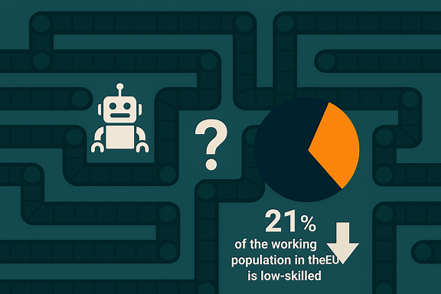
THE INVISIBLE POTENTIAL: REINVENTING TALENT
SITUATION AND CHALLENGES
The Challenges are Undeniable
  Automation
  Lack of basic digital skills development
  Professional and salary stagnation (limited upward mobility)

Slide 7

THE INVISIBLE POTENTIAL: REINVENTING TALENT
SITUATION AND CHALLENGES
Accumulation of Vulnerabilities
  Precarious Jobs: Low salaries, high turnover, insecurity.
  High Risk of Unemployment: First to be laid off in crises (low specialization).
  Low Training Participation: Less than 15% access continuous training.
  Technological changes: Digitalization, AI, Automation.
  Routine and physical tasks are the most automatable.
High Risk: Permanent labor exclusion

Slide 8

THE INVISIBLE POTENTIAL: REINVENTING TALENT
SITUATION AND CHALLENGES
THE PARADOX
The group that most needs to improve its skills is the one that has the least access to it...

Slide 9
THE INVISIBLE POTENTIAL: REINVENTING TALENT
SITUATION AND CHALLENGES
Why are they not trained?
  Lack of Offer: Many jobs do not offer in-house training.
  Lack of Time and Energy: Long hours, physical work, work-life balance.
  Low Motivation: Mistrust, fear of failure, low skilled workers do not see the return.
  Lack of knowledge: They don't know what exists, where or how to access it.

Slide 10
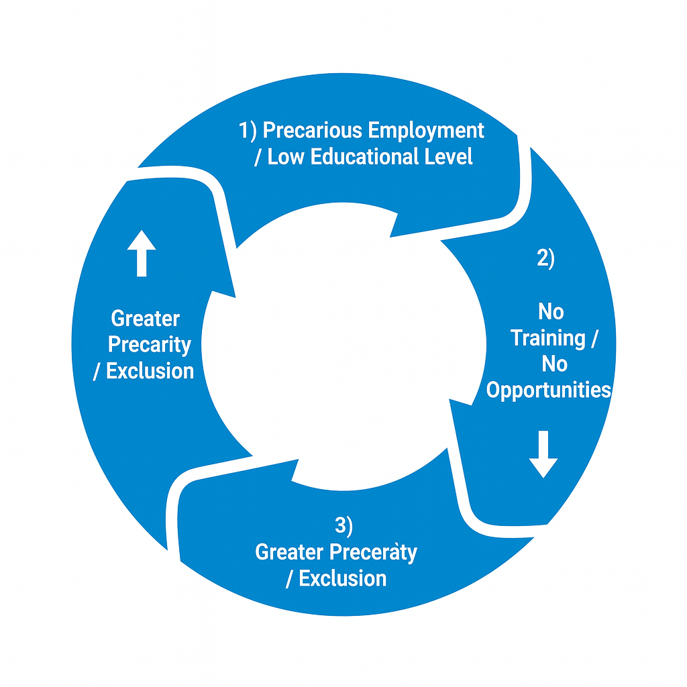
THE INVISIBLE POTENTIAL: REINVENTING TALENT
SITUATION AND CHALLENGES
A Vicious Circle That Feeds Inequality
The question is not "why are they not trained?"
The question is:
What are we doing wrong so that they cannot be trained?
Outdated skills

Slide 11
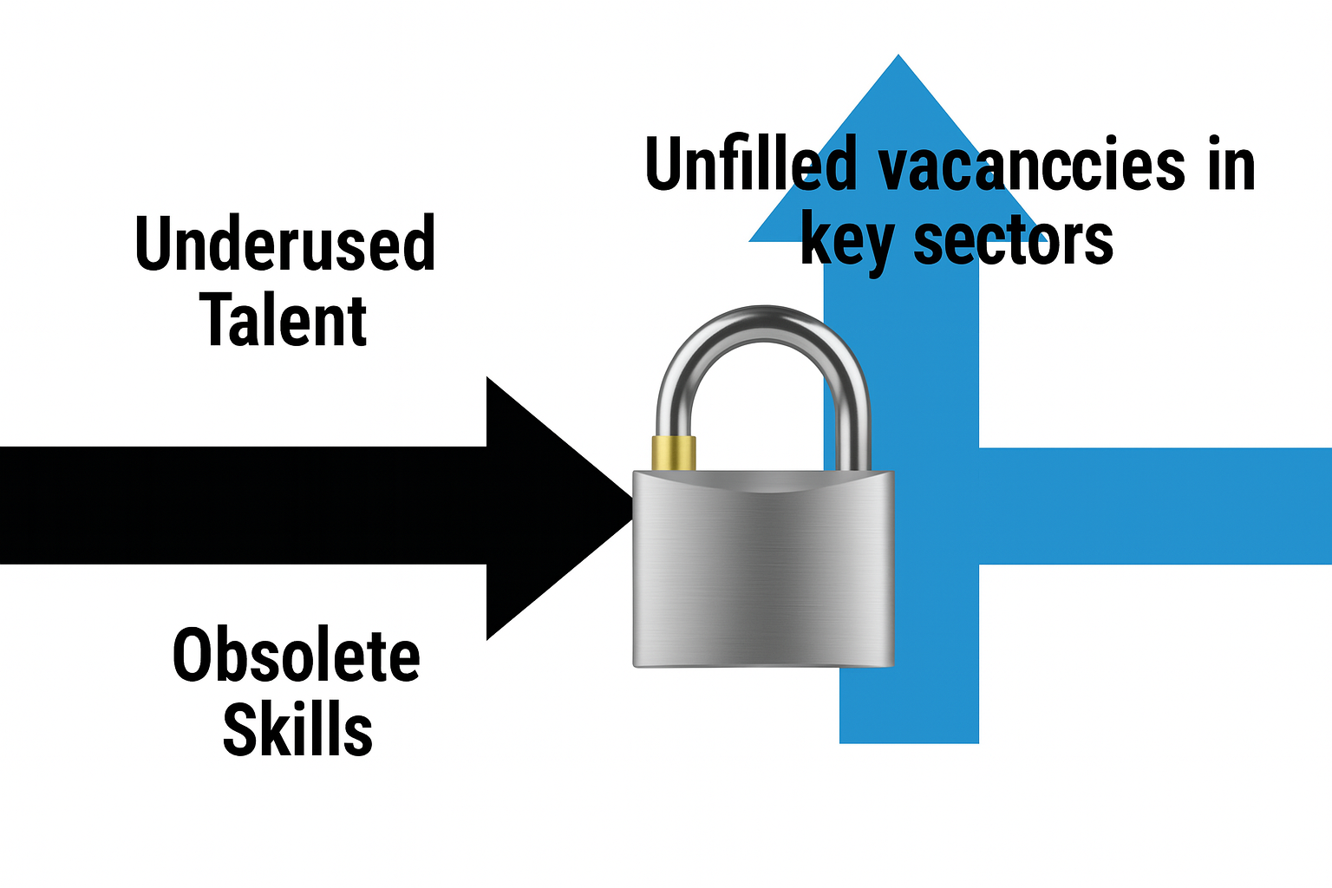
THE INVISIBLE POTENTIAL: REINVENTING TALENT
OPPORTUNITIES AND KEYS FOR IMPROVEMENT
It's not a people problem. It is a SYSTEM CHALLENGE
And the system can be redesigned.
The Opportunity: Connecting Talent with Need
Low-skilled workers can fill today's critical vacancies...
...if they receive the appropriate training and support necessary in their transition.

Slide 12

THE INVISIBLE POTENTIAL: REINVENTING TALENT
OPPORTUNITIES AND KEYS FOR IMPROVEMENT
Challenge + Opportunity = Paradigm Change
  Upskilling: Improve their current skills.
  Reskilling: Train them for new tasks.
  Productivity: Gain efficiency and resilience.

Slide 13

THE INVISIBLE POTENTIAL: REINVENTING TALENT
OPPORTUNITIES AND KEYS FOR IMPROVEMENT
From the Job to the Professional Career
  Specific and accessible training.
  Certification of skills already acquired.
  Career design with progression.
  Greater autonomy and recognition.

Slide 14
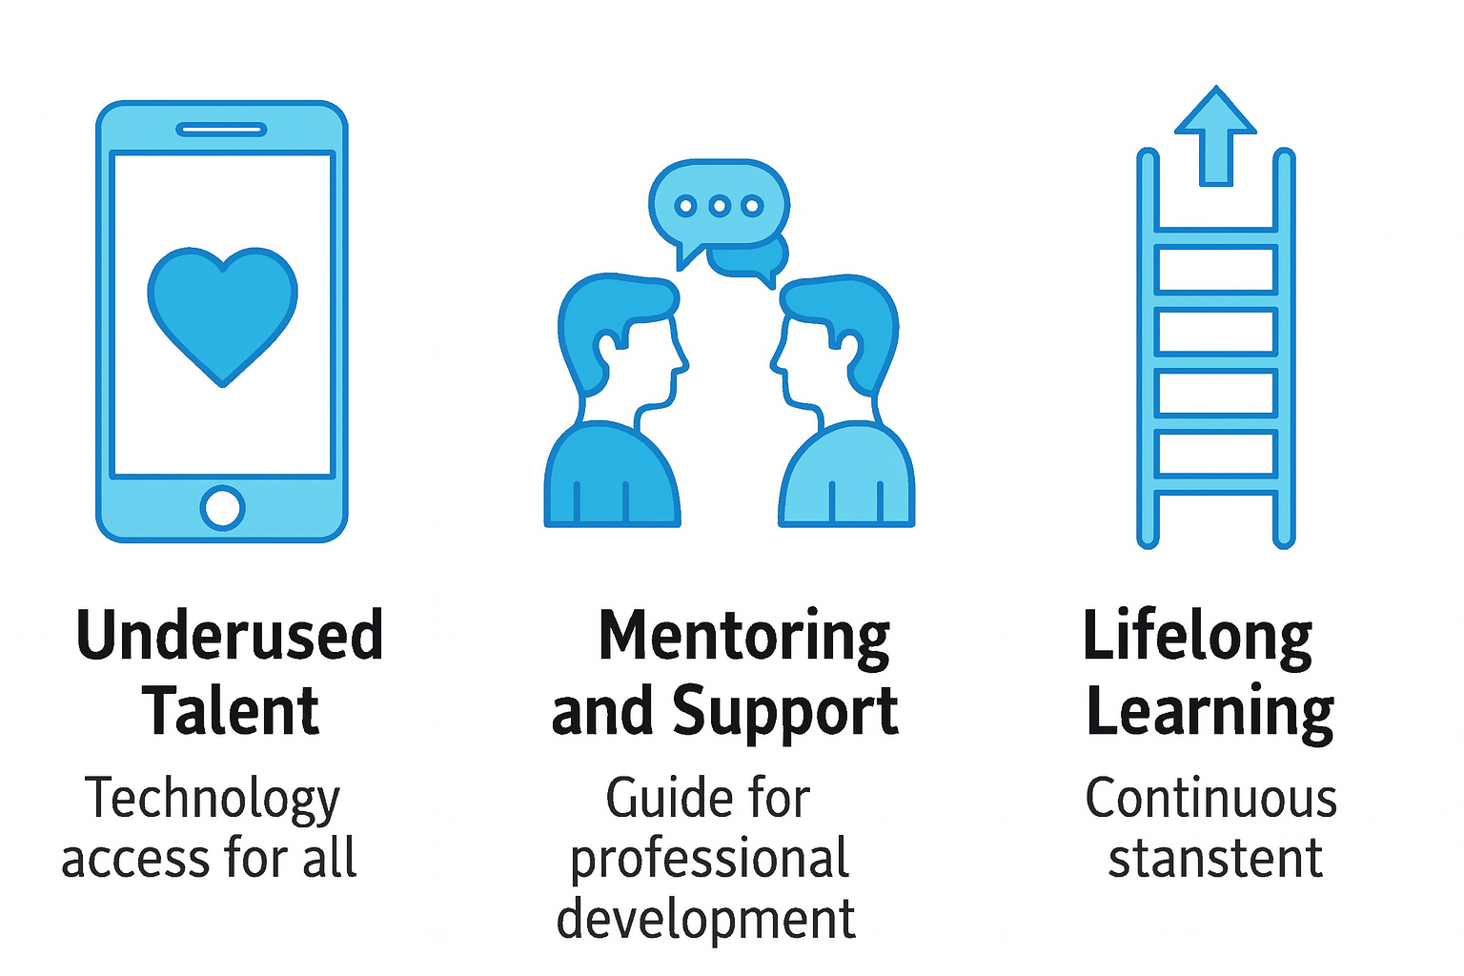
THE INVISIBLE POTENTIAL: REINVENTING TALENT
OPPORTUNITIES AND KEYS FOR IMPROVEMENT
Inclusive Digitization: Basic programs, focused on the tools they will actually use. Without jargon, from their level.
Mentoring and Accompaniment: An internal guide who resolves doubts, motivates and trains in the jobs. Trust is key.
Lifelong Learning: Accessible micro-training integrated into their work, not as an extra burden.

Slide 15
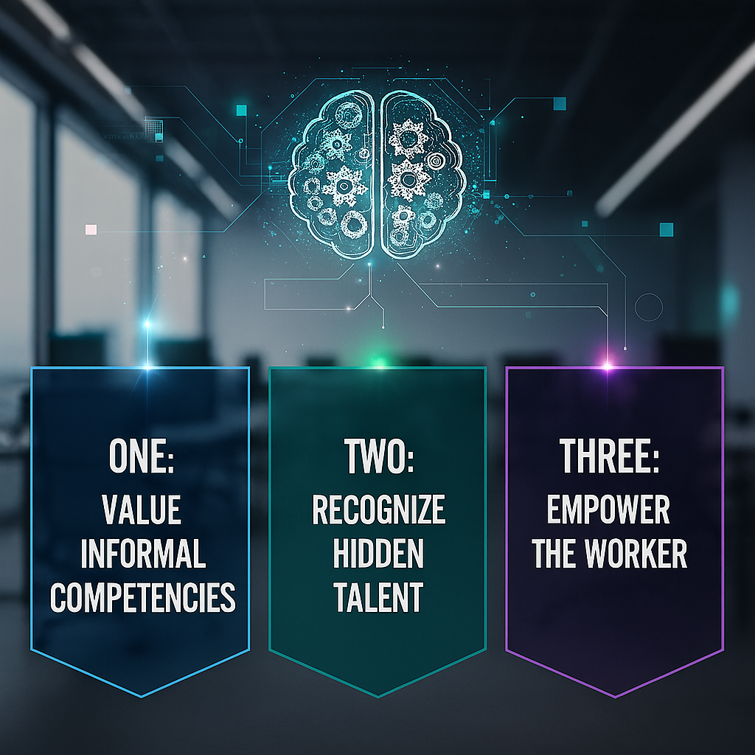
THE INVISIBLE POTENTIAL: REINVENTING TALENT
OPPORTUNITIES AND KEYS FOR IMPROVEMENT
Paradigm Shift: New Rules of the Game
Value informal skills: Prioritize skills over Certificates.
Recognize hidden talent: Promote internal mobility.
Empower the worker: Passive Receiver → Active Agent.

Slide 16
THE INVISIBLE POTENTIAL: REINVENTING TALENT
OPPORTUNITIES AND KEYS FOR IMPROVEMENT
Dynamic 1: Paradigm Change in talent development
Think of 1 example of low-skilled worker that you know (in your company, environment, sector).
VICIOUS CIRCLE: What type of characteristics would you associate with it?
VIRTUOUS CIRCLE: What kind of support or training could be provided to low-skilled workers to enable them to contribute more value at work?
Vicious circle
Virtuous circle
--Low qualification
--
--
--
--
--
--Basic digital skills training
--
--
--
--
--
Notes:
Activity 1: Paradigm shift in talent development (duration 4 min)
Materials: One sheet of paper or Post-it note per person (if in-person) or a digital whiteboard (if online).
Instructions:
1.Think of 1 example of low-skilled workers that you know (in your company, environment, sector) and write down:
VICIOUS CIRCLE: What negative characteristics would you associate with him/her? (eg: Low qualifications, lack of internal training, etc.)
VIRTUOUS CIRCLE: What type of support or training would allow him/her to contribute more value at work? (eg: Basic digital skills, etc.)
2. Discuss the ideas as a group.

Slide 17
THE INVISIBLE POTENTIAL: REINVENTING TALENT
EXPERIENCES AND GOOD PRACTICES
A COMMON CHALLENGE across Europe:
  Many adults have skills learned on the job, but not officially recognized.
  This limits access to better jobs, mobility, and training.
  Need for validation and visibility of informal learning.
  A huge waste of talent

Slide 18
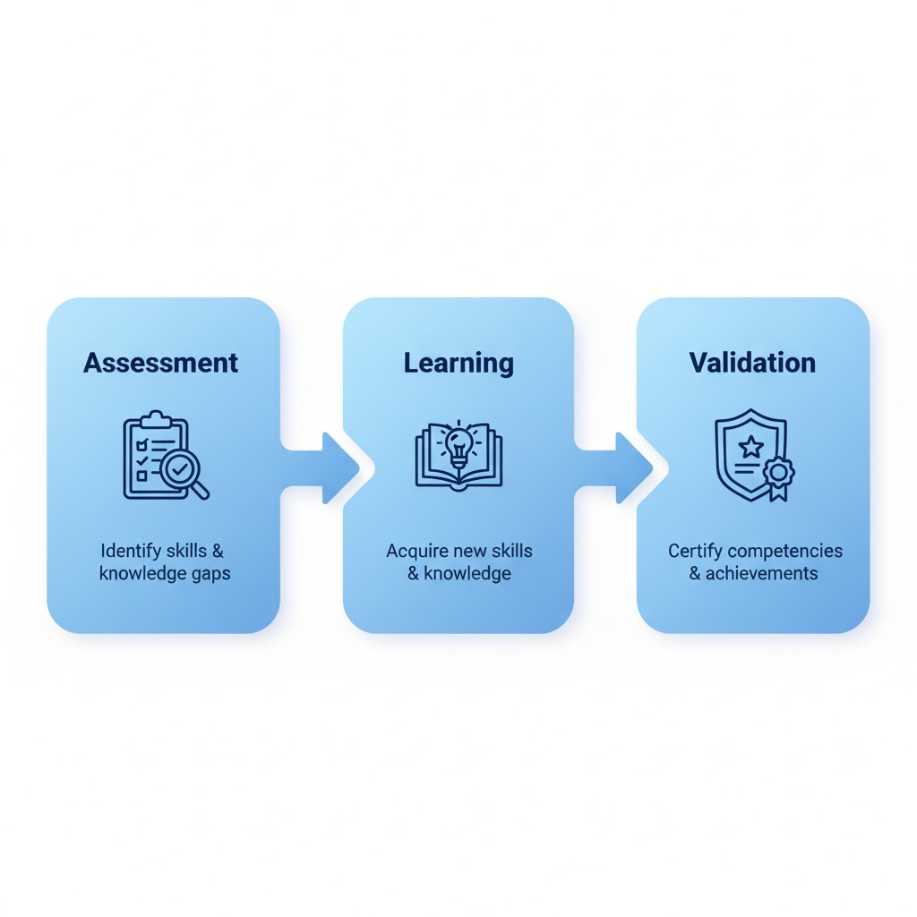
THE INVISIBLE POTENTIAL: REINVENTING TALENT
EXPERIENCES AND GOOD PRACTICES
European tools to recognize and support skills:
  EQF (European Qualifications Framework): makes qualifications comparable across EU countries.
  Europass: It helps people to showcase their skills and competencies, both formal and informal.
  Upskilling Pathways (EU initiative): offers adults low in skills an individualized path:
  Skills assessment
  Tailored training offer
  Validation and recognition
More info: Microquest project. Guideline for VET providers

Slide 19

THE INVISIBLE POTENTIAL: REINVENTING TALENT
EXPERIENCES AND GOOD PRACTICES
More info: Microquest project. Guideline for VET providers
The European Commission promotes microcredentials:
  Flexible and modular learning.
  Short, recognized learning units endorsed by the European Commission.
  Ideal for adults combining work and learning.
  Build progressive qualifications and make lifelong learning visible.
“Recognition and validation of skills are the bridge between potential and opportunity.”

Slide 20
THE INVISIBLE POTENTIAL: REINVENTING TALENT
EXPERIENCES AND GOOD PRACTICES
COCA-COLA and IBERDROLA | Development through Experience (Model 70-20-10) Coca-Cola and Iberdrola apply development models that directly benefit workers with less formal qualifications, as they emphasize on-the-job learning: 70% in the Workplace: performing daily tasks, participating in specific projects or taking on challenges. Continuous improvement (upskilling) through practice and direct mentoring from the supervisor. 20% in Interactions and Coaching: Learning is encouraged through interaction with colleagues and coaching from leaders. Horizontal learning (Lunch and Learn initiative), where employees share their knowledge. 10% Formal Training: Reserved for structured courses. Face-to-face training or through digital platforms. | Reskilling and Upskilling | Meanings and Main Differences – Iberdrola Training and talent development - Iberdrola
MCDONALD’S | Strong internal training + promotion from entry-level positions +400,000 employees have participated in the program $150 million invested in employee education 50% of managers started as entry-level employees | Train and work with McDonald's Germany
AMAZON | Support for the professional growth of employees $700 million 100,000 employees (1/3 of the workforce) would have access to training programs Different training programs (Amazon Technical Academy, Associate2Tech, Machine Learning University, Career Choice, Amazon Apprenticeship, and AWS Training and Certification) support Amazon employees in acquiring crucial skills to access higher-level and better-paying technical and non-technical positions. | Amazon success stories from skills training programs
International company best practices

Slide 21
THE INVISIBLE POTENTIAL: REINVENTING TALENT
EXPERIENCES AND GOOD PRACTICES
TELEFONICA | Telefónica's 'reskilling' program trains more than 16,000 workers in Spain The firm runs one of the largest reskilling programs in Europe. The 2022 reskilling program enabled 40% of its employees to advance to management positions to women. | El 'reskilling' de Telefónica forma a más de 16.000 trabajadores en España
MONDRAGON CORPORATION | A corporation and federation of worker cooperatives based in the Basque Country that places talent development at the center of its model, combining strategic people planning with continuous, accelerated and action-based learning processes. A pioneer in dual training and work-study programs, with a recognized university-business collaboration model that integrates internships, final projects, and other learning experiences applied to real-world challenges faced by cooperatives. It promotes continuous retraining through innovative training platforms and solutions developed in collaboration with Mondragon University and other organizations. | https://www.mondragon-corporation.com/people/site/assets/files/103207/informe-anual-2021-ext.pdf
BIOLAN | It promotes access to education as a key tool for social transformation. It fosters collaboration with universities and educational institutions, currently working with the University of Deusto by integrating students into the company, with the aim of promoting the acquisition of knowledge, skills, and motivation. It supports the inclusion of people with disabilities in the labor market, collaborating with Lantegi Batuak through its Supported Employment (Lanerako) program. | https://biolanmb.com/en/sustainability/
SUTARGI | A community-based social enterprise that places people at the heart of its organizational model and understands learning as a strategic axis for generating social and business impact. Its approach is based on the 70-20-10 model, the use of play as a pedagogical tool, and the creation of personalized learning pathways tailored to the needs, abilities, and interests of its employees. | https://sutargi.org/personas/
More Spanish and Basque Country company practices

Slide 22
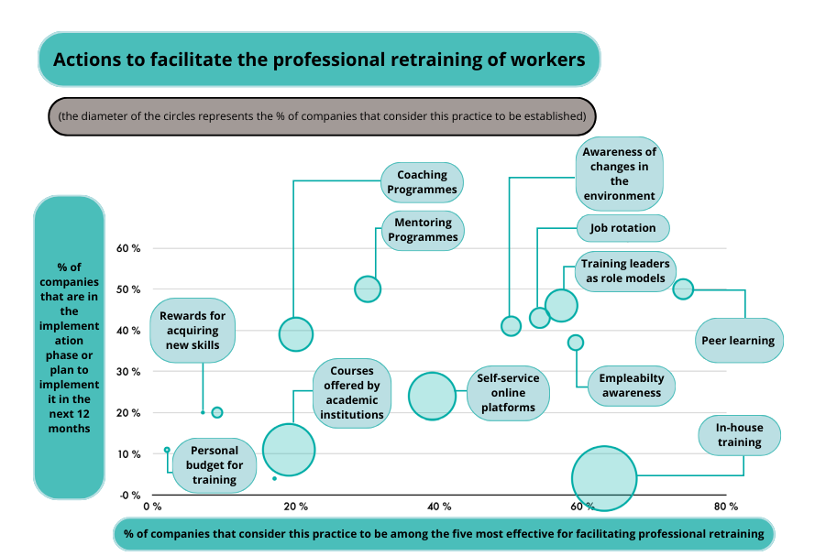
THE INVISIBLE POTENTIAL: REINVENTING TALENT
EXPERIENCES AND GOOD PRACTICES
Source: EY “Las empresas españolas frente a la revolución del reskilling” report.
September 2020

Slide 23
THE INVISIBLE POTENTIAL: REINVENTING TALENT
STRATEGIC RECOMMENDATIONS
Dynamic 2: Hidden talent map
Aim: View internal training opportunities within the company.
Think about a low-skilled worker in your company ……
Strengths or informal competencies
-
-
-
-
-
-
What would he/she need to learn?
-
-
-
-
-
-
How to support that development
-
-
-
-
-
-
“The challenge is not to find talent outside, but to activate it inside”
Notes:
Activity 2: Hidden Talent Map (duration 4-5 min)
Materials: One sheet of paper or Post-it note per person (if in-person) or a digital whiteboard (if online).
Instructions:
1. Ask them to think of a low-skilled worker in their company (fictitious name).
2. Write down:
What he / she does well (strengths or informal skills), 2-3 ideas.
What he / she would need to learn to take on new tasks; 2-3 ideas.
Specific ideas about how they could support this development (Create internal training programs, Introduce mentoring and coaching, Identify and leverage hidden talent, etc.). 2-3 ideas.
3. Discuss the ideas as a group.

Slide 24
THE INVISIBLE POTENTIAL: REINVENTING TALENT
CONCLUSION
The KEY is in :
  Recognize previous competencies.
  Provide access to flexible and adapted training.
  Motivate with real internal promotion itineraries.
  Promote a culture of lifelong learning in SMEs.
“Investing in the training of the least qualified is not an expense, it is the best strategy against the talent shortage in Europe.”

Slide 25
THANK YOU

