Slide 1








EU and National Legislation for Migrant Workers
December 2025/ Meath Partnership

Slide 2



Unit 18 Migrant Workers Agenda
Migrant Workers Employment Legislation
    EU Key Legislation
    Diversity, Equity and Inclusion: Anti-discrimination
    Human Trafficking
    Upskilling your workforce
    Pension rights for migrants
    National Legislation

Slide 3
Key EU Legislative Pillars
The Employment Equality Directive provides protection against discrimination in employment on the grounds of, among others, age and disability
Single Permit Directive (2011/98/EU) ensures non-EU nationals are treated equally and fairly and not subjected to expolitation
Equal Opportunities Directive: ensure the implementation of the principle of equal opportunities and equal treatment of men and women in matters of employment and occupation
EU working Time Directive: ensures that employees do not exceed an average working week of 48 hours, including overtime, over a reference period of up to four months. It also guarantees minimum daily and weekly rest periods, as well as paid annual leave
EU Charter of Fundamental Rights, Article 21, prohibits discrimination

Slide 4
EU worker minimum rights cover:
    health and safety at work: general rights and obligations, workplaces, work equipment, specific risks and vulnerable workers
    equal opportunities for women and men: equal treatment at work, pregnancy, maternity leave, parental leave
    protection against discrimination based on sex, race, religion, age, disability and sexual orientation
    labour law: part-time work, fixed-term contracts, working hours, employment of young people, informing and consulting employees

Slide 5
Anti-Discrimination
EVERY employee is protected by EU Labour Laws and national legislation
Directive 2006/54/EC - equal opportunities, provides the legal definitions for the terms ‘direct discrimination’, indirect discrimination’, ‘harassment’, ‘sexual harassment’, ‘pay’ and ‘occupational social security schemes’.
Discrimination in employment on any one of the following grounds is illegal:
      Age; Gender; Marital status; Family status; Disability; Race; Sexual orientation; Religious beliefs; or a combination of any stated
      Advertisements for employment must not be discriminatory, whether stated, implied or give the impression of discrimination

Slide 6
Diversity, Equity and Inclusion (DEI)
  Gender Equality Strategy 2020-2025: address gender disparities by promoting equal pay, combating gender-based violence, and ensuring balanced representation in decision-making roles
  LGBTIQ Equality Strategy 2020-2025: ensures the rights and safety of LGBTIQ individuals, addressing discrimination and advocates for inclusive policies across member states
  EU Anti-Racism Action Plan 2020-2025: to tackle racial and ethnic discrimination, and outlines measures to combat racism in employment, education, and housing
  Strategy for the Rights of Persons with Disabilities 2021-2030: this strategy focuses on accessibility, inclusion, and equal opportunities for individuals with disabilities
  EU Roma Strategic Framework 2020-2030: dedicated to promoting equality, inclusion, and participation of Roma communities, addressing challenges faced by Roma

Slide 7
Diversity, Equity and Inclusion
EU Motto - United in Diversity
Diversity and Inclusion Strategy 2030… embraces an intersectional approach to diversity and an integrated approach to inclusion
DEI regulates for fair treatment, equal opportunities, and representation for all individuals, focusing on gender, ethnicity, disability, and sexual orientation
Mandatory reporting requirements for employers such as Pay transparency; gender balance;
Pillars of DEI:
Diversity refers to employees’ backgrounds, skill sets, and abilities
Equity refers to the fairness of all team members and addresses these disparities in DEI programs
Inclusion creates a positive work culture where all employees feel welcome.

Slide 8
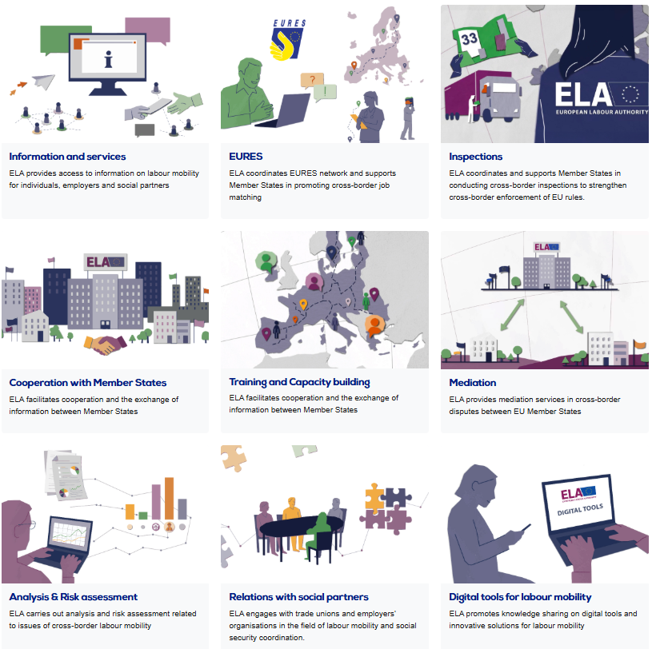
European Labour Authority (ELA)
Established in EU law in 2019 to:
    strengthen fairness and trust in the internal market
    ensure that EU rules on labour mobility and social security coordination are enforced in a fair and effective way
    make it easier for individuals and businesses to benefit from the internal market of the European Union

Slide 9
“Intra-EU relocation flows have increasingly served as a channel of economic adjustment between EU countries, but immigration from outside the EU is playing an increasingly important role in meeting labour demand”
Migration, mobility and the EU labour market. European Commission. Nov 2025

Slide 10
Employing EU Nationals
The freedom to move to another EU country to work without need for a work permit is a fundamental principle right granted to EU nationals.
EU citizens are entitled to:
    seek employment in another EU country
    work in an EU country without the necessity of a work permit
    reside in an EU country for the purpose of the employment
    remain in the EU country after cessation of the employment
    enjoy equal treatment with nationals in accessing employment, work conditions and all other social and tax advantages

Slide 11
Employing EU Nationals
EU nationals have the right to look for a job in another Member State
They will receive the same assistance as nationals from the host Member State national employment offices.
Any EU national has the right to stay in the host country for a period long enough to look for work, apply for a job and be recruited.
Jobseekers cannot be expelled if they prove that they are continuing to seek employment and have a genuine chance of finding a job.
European Commission: The right to look for a job

Slide 12
The Single Permit Directive
“...joining the Single Permit Directive and enabling spouses or partners of workers to also contribute to the economy will be key in ensuring that we can bring much needed skills and experience to the labour market across all sectors of the economy.”
Justice Minister Helen McEntee, Ireland. 2024

Slide 13
Employing Non- EU Nationals
Non-EU nationals may have the right to work in an EU country or the right to be treated equally with EU nationals regarding work conditions, depending on their nationality or their status and are determined by different legal instruments
Non-EU nationals may have the right to work in an EU country or to be treated equally with EU nationals as regards conditions of work.
These rights depend on their status as family members of EU nationals and on their own nationality.
European Commission, employment Social Affairs and Inclusion

Slide 14
Single Permit Directive
The Single Permit Directive 2024, is a more simplified process that gives non-EU workers the right to be treated equally with nationals of EU Member State
Ensures fair treatment of non-EU workers legally residing in a Member State and at preventing exploitation
The directive addresses working conditions, such as pay, working hours, health and safety requirements, education and training, recognition of qualification and tax benefits
Must be transposed into national law by the 1st of May 2026

Slide 15
Revisions to the Single Permit Directive 2024
Introduced a single application procedure for residency and work permits
Holders of a valid residence permit can apply directly from the EU without having to go back to their country of origin
Applications can be made from within the Member State
Member States must rule on an application in a single application within 90 days
right to change employers
Workers can remain in employment while applying for an extension to remain
Temporary unemployment is no longer a ground for automatic permit withdrawal. Permit holders retain their right to reside for up to three to six months if they have held a valid permit for at least two years.

Slide 16
Permit holders are entitled equal treatment with nationals (though Member States may apply some restrictions):
    employment and working conditions, including pay, working hours, leave, holidays;
    health and safety at the workplace
    the right to strike and take industrial action, and membership in trade unions
    education and vocational training
    the recognition of qualifications
    certain branches of social security and tax benefits
    access to public goods and services, access to public and private housing, and advice from employment offices

Slide 17
Other countries that have an agreement with the EU
Nationals of these countries, who are working legally in the European Union, are entitled to the same working conditions as the nationals of their host country:
    Algeria, Morocco, Tunisia
    Russia
    Albania, Montenegro, North Macedonia
    Bosnia and Herzegovina, Kosovo*, Serbia, Ukraine
    Andorra, San Marino
    79 countries of the African, Caribbean and Pacific Group of States

Slide 18
Human Trafficking
Human trafficking is the transport of humans for exploitation, with migrant women being the most at risk
Forced labour, servitude, slavery, child labour, forced begging rings or criminal activities
EU anti-trafficking directive criminalises forced labour and exploitation
Human trafficking is not the same as pepole smuggling

Slide 19
Upskilling your workforce
  The European Pillar of Social Rights is a suite of 20 key principles and rights essential for fair and well-functioning labour markets and social protection systems.
  Migrant workers have the right to quality and inclusive education, training and life-long learning in order to maintain and acquire skills that enable them to pacipate fully in society and manage successfully transitions in the labour market.
  Migrant workers have the right to receive support for job search, training and re-qualification
  Migrant workers have the right to transfer social protection and training entitlements during professional transitions

Slide 20

National Employment Legislation
AUSTRIA
EEA Freedom of Movement
Employment of Foreign Nationals Act
Red -White card points system
Non EU workers: Single Permit Act - 01 May 2026
Federal Government Migration Portal

Slide 21

National Employment Legislation
Germany
Skilled Immigration Act
EU Blue Card
Residence Act
Job Search Opportunity Card
* Quick-check for Employers

Slide 22

National Employment Legislation
Spain
Royal Decree Regulations of Immigration Act 1155/2024
Extraordinary Regularization (2026)
TIE Aliens Identification Card

Slide 23

National Employment Legislation
Italy
Decree Law 179/2025
Decreto Flussi Italia

Slide 24

National Employment Legislation
Ireland
Employment Permits Act 2020
Employment Permits Regulations 2017 (SI No 95 of 2017
Economic Migration Policy

Slide 25
Additional reading:
EU Single Permit Directive
Employment and Social Affairs
European Network Against Racism
EURES EU Employment Services
Diversity and Inclusion Strategy 2030

Slide 26

THANK YOU
Funded by the European Union. Views and opinions expressed are however those of the author(s) only and do not necessarily reflect those of the European Union or OeAD-GmbH. Neither the European Union
nor the granting authority can be held responsible for them. Project N° 2023-1-AT01-KA220-VET-000152934

Slide 27
Funded by the European Union. Views and opinions expressed are however those of the author(s) only and do not necessarily reflect those of the European Union or OeAD-GmbH. Neither the European Union
nor the granting authority can be held responsible for them. Project N° 2023-1-AT01-KA220-VET-000152934

