Slide 1
Monitoring – Indicators and Tools

Slide 2
Monitoring – Why, What and How?
Implementation of strategic actions on company level need monitoring of performance and success
Gives ongoing (formative) information about performance and achievement of strategic goals
Allows for steering, corrections and adaptation of actions if necessary
Allows for stopping the implementation of strategies if necessary
Prevents bad surprises in the end
Is part of the strategic P-D-C-A circle for strategy implementation

Slide 3
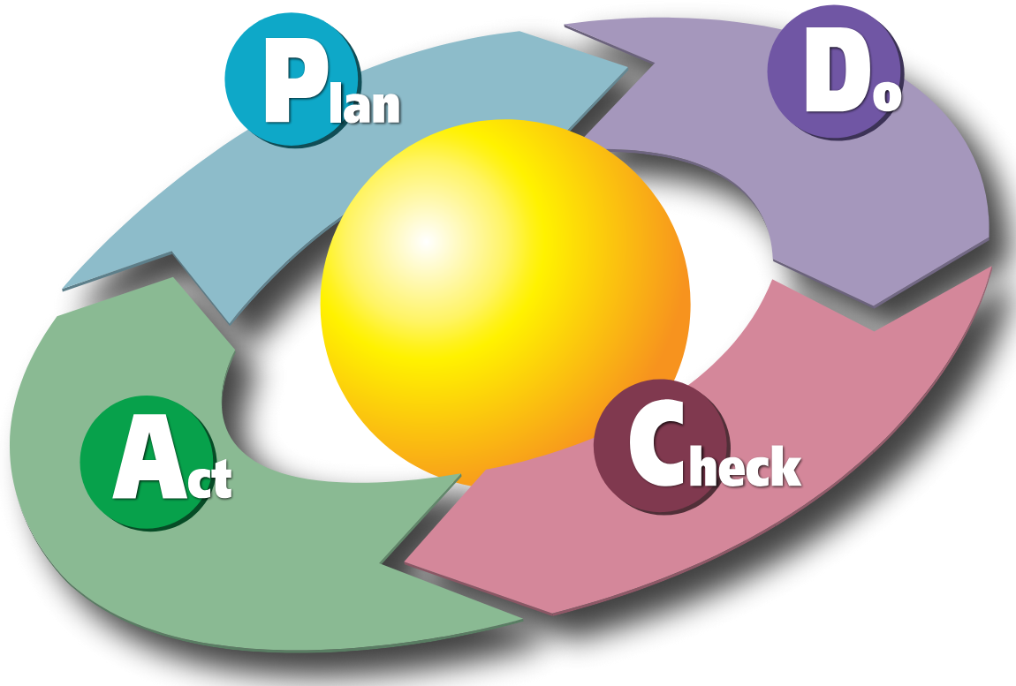
Monitoring – Why, What and How?
MONITORING
By Karn-b - Karn Bulsuk (http://www.bulsuk.com

Slide 4
Monitoring – Why, What and How?
Monitoring – CHECK is all about:
to verify whether the plan is working as intended and to generate insights that guide improvements in the Act phase
Without proper monitoring and evaluation, it is unclear if your strategy and actions are targeted, reach the planned outcomes or are at risk to fail.
Without proper monitoring the PDCA circle is NOT working

Slide 5
Monitoring – Why, What and How?
Key activities in the monitoring phase of your strategy are:
Collect data and results from the „Do“ phase (measuring key performance indicators KPI‘s, metrics or observation)
Compare the actual results to the plan (variance or deviation analysis)
Analyse discrepancies or deviations in detail
Deduct actions, steering mechanisms and documentation for the next phase „Act“.

Slide 6
Monitoring – Why, What and How?
Which methods and tools may be used for monitoring and deviation analysis?
KPI‘s – Key Performance Indicators
Employee Surveys and Feedback Systems
Performance appraisal systems (e.g. 360 degree Feedback)
External (also internal) audits
Benchmarking
Observation and managerial reports
Many others…

Slide 7
Monitoring – Why, What and How?
Important selection criteria:
Criterion | Description | Why It Matters
1. Relevance | The method should measure what truly matters to business goals (e.g., employee turnover, time-to-hire). | Avoids collecting “nice-to-know” but irrelevant data.
2. Simplicity & Ease of Use | Easy for managers or HR staff to apply regularly without specialized training. | Small teams can sustain it long-term.
3. Cost-Effectiveness | Minimal cost in tools, software, or time. | Keeps overhead low for small businesses.
4. Data Reliability | Data collected should be accurate and consistent. | Prevents misleading decisions.
5. Frequency & Timeliness | Ability to monitor at appropriate intervals (monthly, quarterly). | Enables quick corrective actions.
6. Integration & Automation | Compatibility with existing systems (like payroll or HR software). | Reduces manual work and errors.
7. Actionability | The method should produce results that lead to clear actions or improvements. | Ensures monitoring leads to impact, not just reporting.

Slide 8
Monitoring – Why, What and How?
Possible monitoring tools:
KPI‘s – Key Performance Indicators
HR metrics and statistics
Qualitative surveys

Slide 9
Monitoring – Why, What and How?
Key Performance Indicators:
Key Performance Indicators (KPIs) in Human Resources (HR) are measurable values that help organizations track and evaluate the effectiveness and efficiency of their HR processes. They connect HR activities to business outcomes and help identify areas for improvement.

Slide 10
Monitoring – Why, What and How?
For your monitoring of keeping senior workers longer in your company, possible KPI’s could be:
KPI | Definition | Purpose
Average Employee Age | Mean age of workforce. | Monitors workforce aging trends.
% of Employees Aged 50+ (or 55+) | Employees aged 50+/55+ ÷ total employees × 100. | Measures representation of experienced staff.
Retention Rate of 50+ Employees | (Employees aged 50+ who remain in company ÷ total 50+ employees at start of period) × 100. | Key indicator for retention success.
Turnover Rate (50+ Employees) | (Number of 50+ employees who leave ÷ total 50+ employees) × 100. | Identifies potential attrition issues.
Average Tenure of Employees 50+ | Average years of service of 50+ employees. | Reflects longevity and commitment.
Exit Rate Due to Retirement | % of total exits caused by retirement. | Helps anticipate workforce planning needs.

Slide 11
KPI | Definition | Purpose
% of Older Employees in Mentorship Roles | (Number of 50+ employees mentoring others ÷ total 50+ employees) × 100. | Tracks active knowledge sharing.
Mentorship Program Participation Rate | (Employees involved in intergenerational mentoring ÷ total eligible employees) × 100. | Evaluates program reach.
Success Rate of Knowledge Transfer Initiatives | % of departments with completed succession or handover plans. | Ensures organizational knowledge continuity.
Engagement Score (50+ Employees) | Survey-based engagement index for older employees. | Core measure of motivation and belonging.
Absenteeism Rate (50+ Employees) | (Total absence days ÷ total available workdays for 50+ employees) × 100. | Reflects health and morale.
Health & Wellness Program Participation (50+) | % of 50+ employees using wellness initiatives. | Gauges health-support effectiveness.
Retirement Readiness Satisfaction | Survey score on confidence in transitioning into flexible or phased retirement. | Tracks perceptions of career security.

Slide 12
KPI | Definition | Purpose
% of 50+ Employees on Flexible or Part-Time Contracts | Measures uptake of alternative work arrangements. | Indicates company’s adaptability to aging workforce.
Internal Mobility Rate (50+) | % of older employees moving to new roles or reassignments. | Tracks opportunities for continued engagement.
Retention Rate Post-Flexibility Implementation | Retention of older employees who use flexible work options. | Evaluates impact of such policies.
% of Projects with Senior Expert Involvement | Share of strategic projects involving 50+ employees. | Measures knowledge utilization.
Productivity per Employee (50+) | Revenue or output generated per older employee. | Demonstrates contribution to performance.
Mentorship Satisfaction (Younger Employees) | Survey score on perceived value of mentorship from experienced staff. | Captures cross-generational value creation.

Slide 13
Monitoring – Why, What and How?
Selecting, defining and operating with Key Performance indicators:
Choose 3-5 KPI‘s per target group / section (observe selection criteria)
Define the target values at the end of the strategy implementation for each KPI
Define the mesurement points and time frame for each KPI
Insert these data into a KPI dashboard

Slide 14
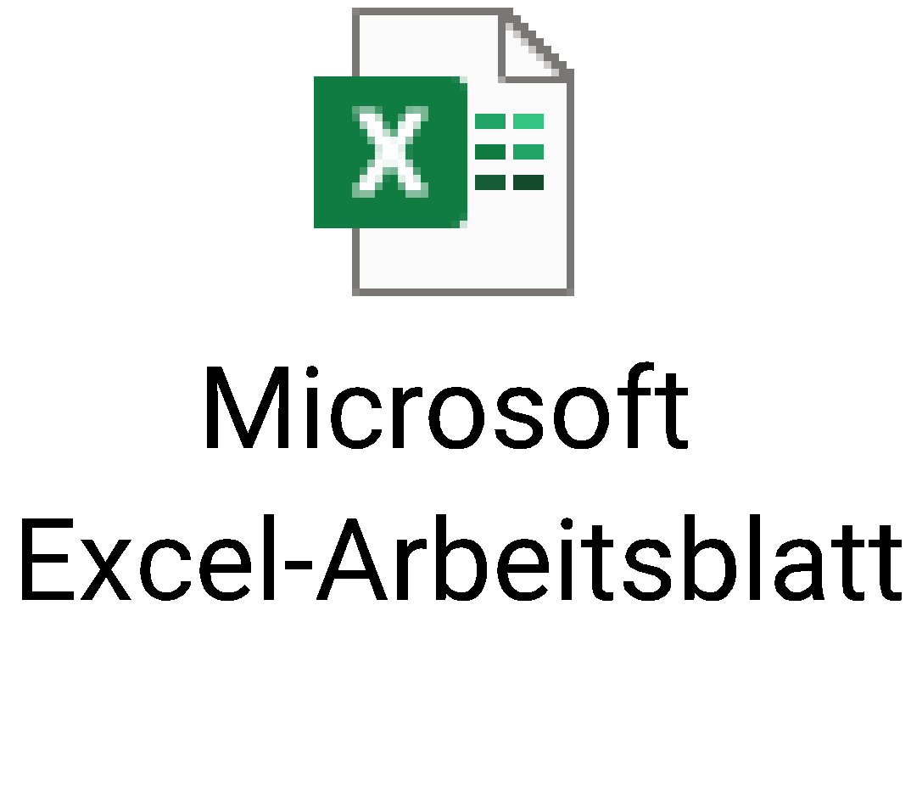
Monitoring – Why, What and How?
KPI Monitoring Dashboard

Slide 15
Monitoring – Why, What and How?
5) Implement the monitoring activities periodically according to the plans in the monitoring dashboard
6) Detect variations and deviations, mark negative deviations with a traffic light system
7) For yellow or red indicators, develop modification or adaptation measures to keep you KPIs on track
8) At the end of the monitoring process, document achieved KPIs and possible deviations for deduction of new actions and measures in the sense of closing the P-D-C-A circle

Slide 16
Monitoring – Why, What and How?

Slide 17
THANK YOU

