Slide 1
General information on senior workers, Best practice, management & leadership approaches
Day2 Unit 11 | IHKPG

Slide 2
Welcome & Ground Rules
Welcome & Ground Rules
  Duration: 45 minutes
  Format: Short presentation + space for discussion
  Ground Rules:
    Open and respectful dialogue
    Everyone’s perspective matters – please share your thoughts
    Reflect on your own organisational context throughout the session
    Aim for constructive and practical insights
    Self reflection / Prompt for reflection
Key Message: Your engagement makes this session valuable.

Slide 3
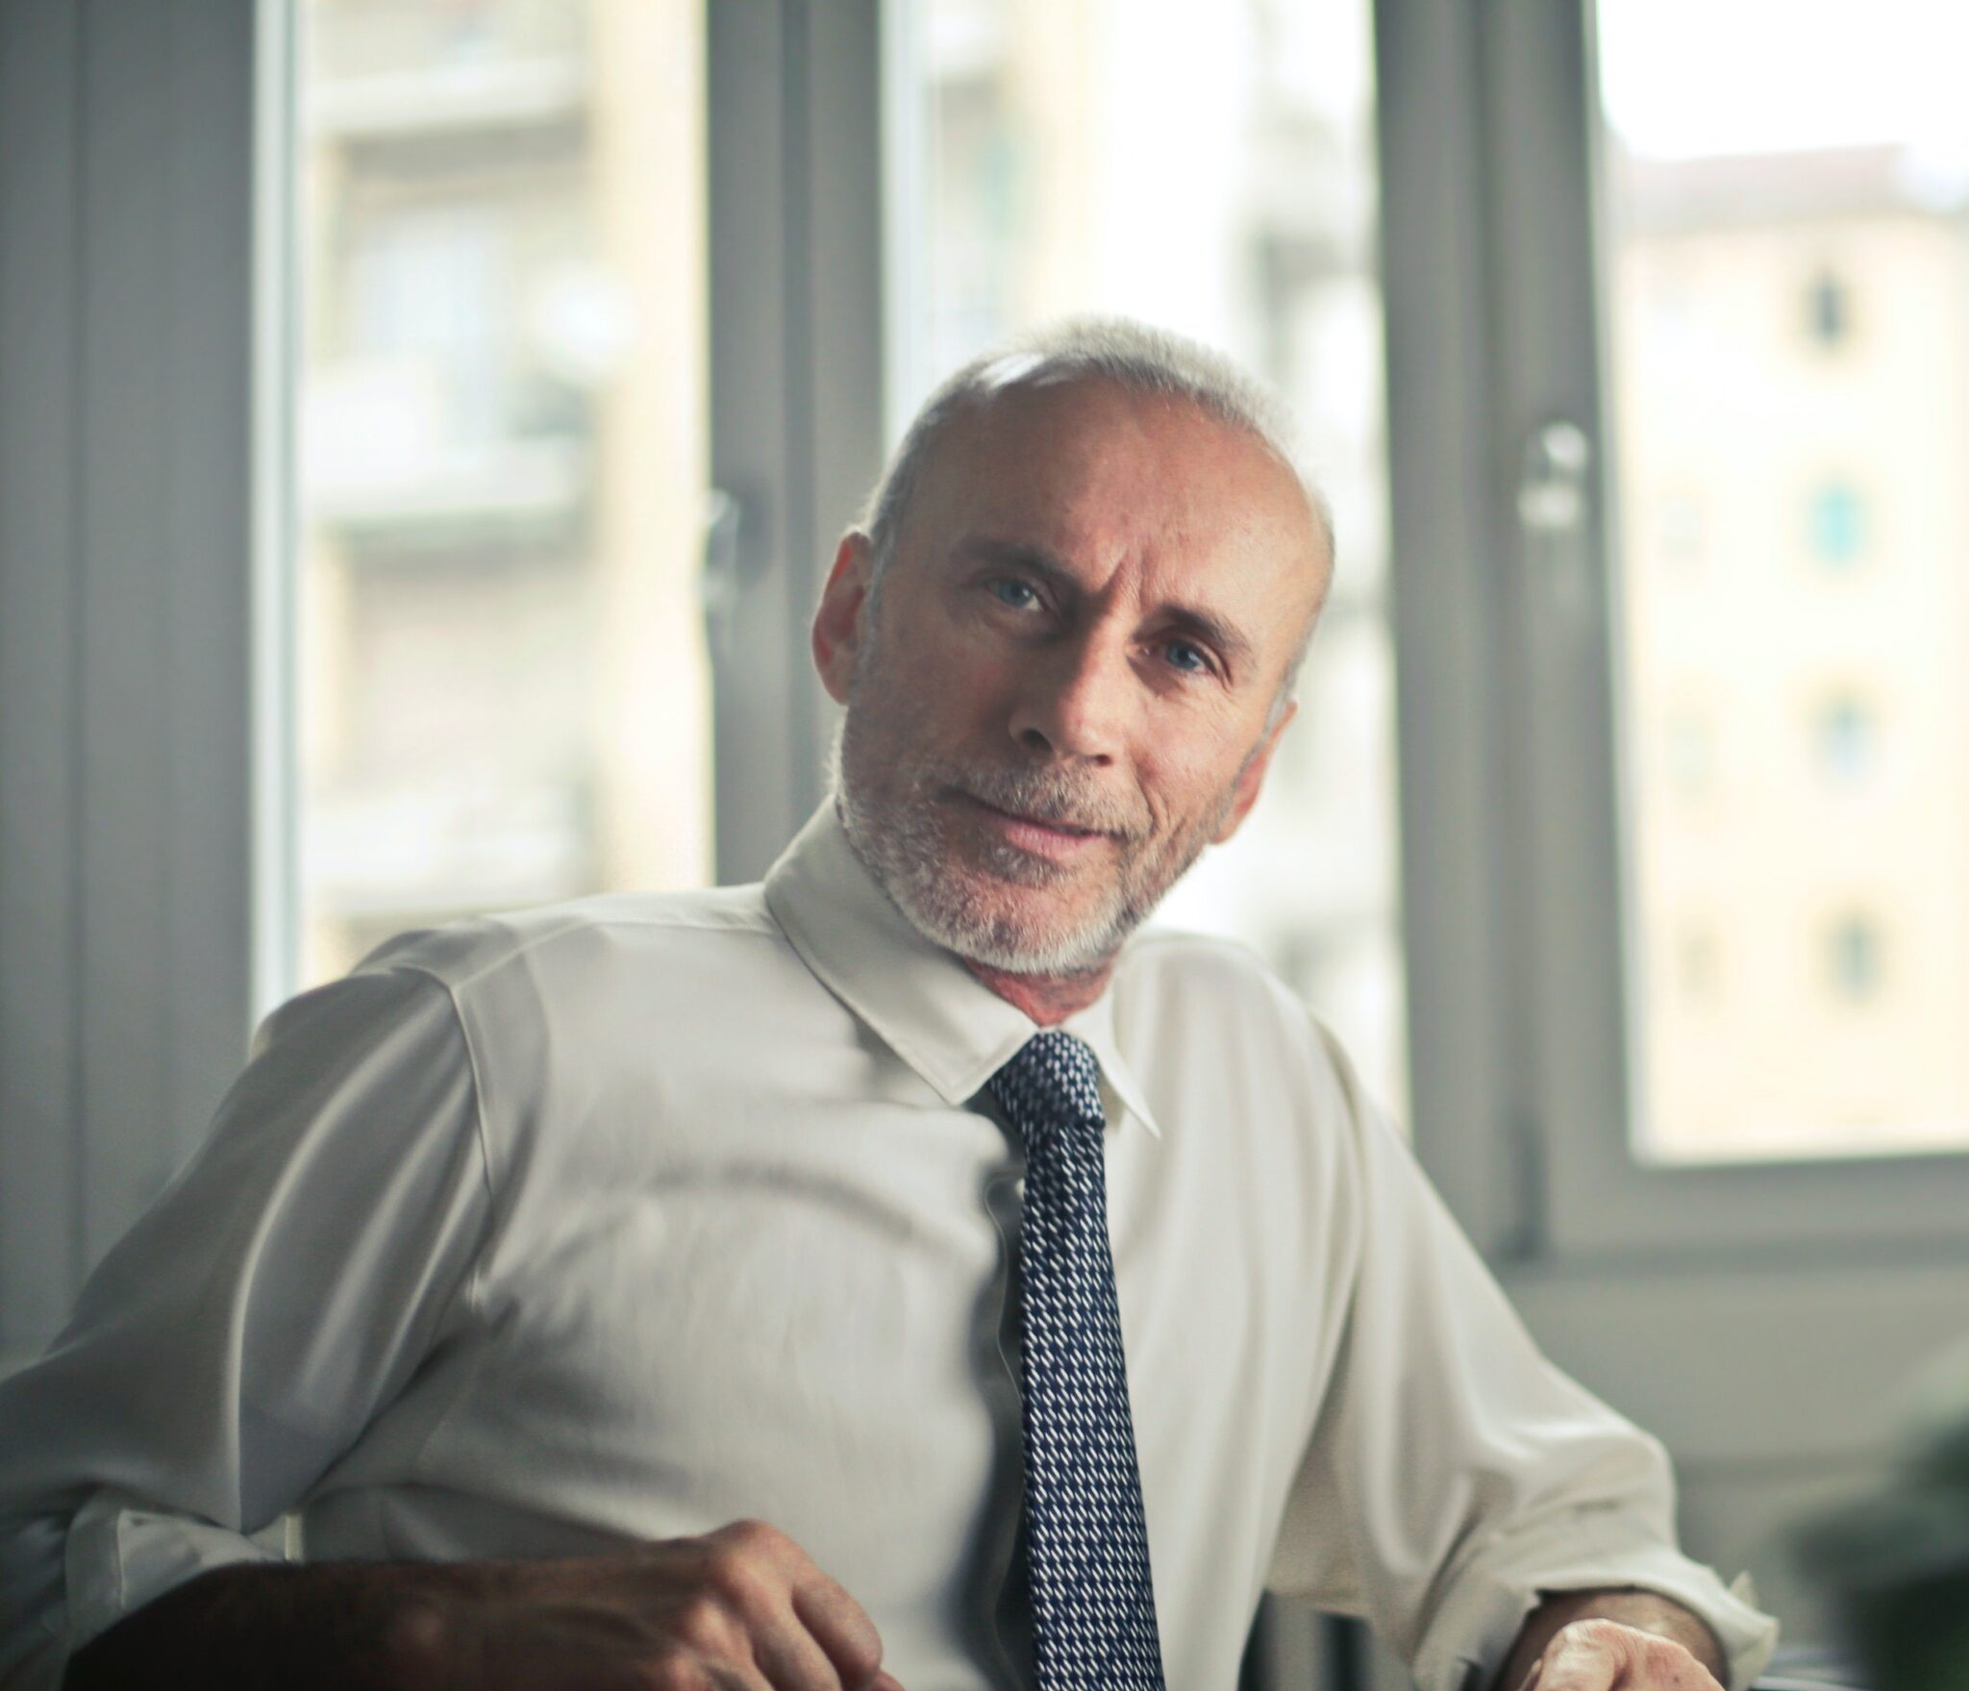
Introduction
Senior workers (55 +) are increasingly seen in European policy and business debates as an important but under-utilized resource in addressing the skilled workforce shortage
a key challenge for small and medium-sized enterprises (SMEs) across the EU.
Key Message: Oldie But Goodie !!
Notes:
Source:
Eurostat. (2025, March 5). 3.7 million women held managerial positions in 2023. Retrieved from https://ec.europa.eu/eurostat/web/products-eurostat-news/w/edn-20250305-1
Eurostat. (n.d.). Employment and unemployment (Labour Force Survey). Retrieved from https://ec.europa.eu/eurostat/web/lfs/database

Slide 4
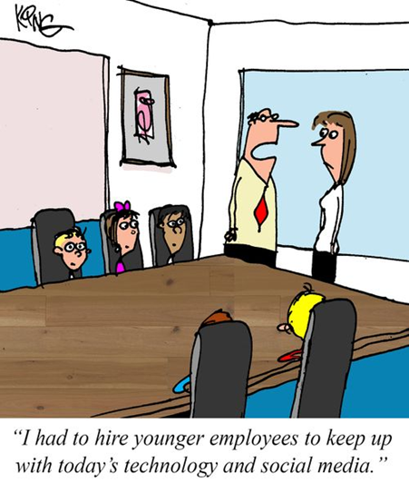
Introduction
Why the EU needs senior workers?
Demographic change is a major driver of labour and skills shortages in Europe:
Younger cohorts entering the workforce are smaller than older cohorts exiting due to retirement.
Many SMEs report difficulty recruiting staff with the right skills roughly around two-thirds are affected by shortage.
💡 Prompt for Reflection: What experiences have you had with older employees in your company?”
Notes:
Source:
Eurostat. (2025, March 5). 3.7 million women held managerial positions in 2023. Retrieved from https://ec.europa.eu/eurostat/web/products-eurostat-news/w/edn-20250305-1
Eurostat. (n.d.). Employment and unemployment (Labour Force Survey). Retrieved from https://ec.europa.eu/eurostat/web/lfs/database

Slide 5
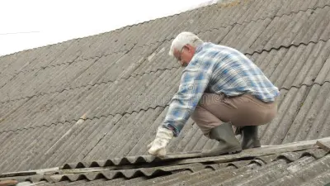

Potential
Potential contributions of senior workers
Older workers’ participation has risen in some countries, and there is still untapped workforce potential among those but we have different challenges
Group 1:
aged 50–63 (elderly workforce !must work (formal retirement not possible) but have sometimes problems for e.g. Health issues; Problems with digitalization...
Group 2:
aged 63-67+ (later retirement !can work (retirement age formally reached!) but want to continue working for e.g. Increased Financial Security; Mental and Emotional Fulfillment;…
Let´s check Barriers & Benefits at te next slides….
Notes:
Source:
Eurostat. (2025, March 5). 3.7 million women held managerial positions in 2023. Retrieved from https://ec.europa.eu/eurostat/web/products-eurostat-news/w/edn-20250305-1
Eurostat. (n.d.). Employment and unemployment (Labour Force Survey). Retrieved from https://ec.europa.eu/eurostat/web/lfs/database

Slide 6
Barriers
Later retirements, while beneficial for some, can present challenges for both employees and employers. Here are some potential problems:
For Employees:
Health Issues: Physical or mental fatigue can be exacerbated by the demands of a job, especially in physically demanding or high-stress roles.
Burnout: The longer people work, the higher the risk of burnout, which can impact performance and job satisfaction.
Changing Skills: Older employees may struggle to keep up with new tools, methods, or technologies.
Work-Life Balance: As people get older, they may want to spend more time with family, focus on hobbies, or travel.
Pension and Savings: Employees may need to reassess their pension plans to accommodate a later retirement.
Notes:
Source:
Eurostat. (2025, March 5). 3.7 million women held managerial positions in 2023. Retrieved from https://ec.europa.eu/eurostat/web/products-eurostat-news/w/edn-20250305-1
Eurostat. (n.d.). Employment and unemployment (Labour Force Survey). Retrieved from https://ec.europa.eu/eurostat/web/lfs/database

Slide 7
Barriers
Later retirements, while beneficial for some, can present challenges for both employees and employers. Here are some potential problems:
For Employers:
Increased Healthcare Costs: Older employees tend to require more medical attention..
Succession Planning Issues: Employers may struggle with succession planning when older employees delay retirement.
Workforce Diversity and Fresh Ideas: Younger employees often bring fresh ideas, which can be important for innovation and adapting to market changes
Training and Development Costs: Employers may need to invest in additional training for older employees.
Retention of Talent: Some employees may feel less motivated if they see colleagues staying longer than they expected to.
Notes:
Source:
Eurostat. (2025, March 5). 3.7 million women held managerial positions in 2023. Retrieved from https://ec.europa.eu/eurostat/web/products-eurostat-news/w/edn-20250305-1
Eurostat. (n.d.). Employment and unemployment (Labour Force Survey). Retrieved from https://ec.europa.eu/eurostat/web/lfs/database

Slide 8
Barriers
Later retirements, while beneficial for some, can present challenges for both employees and employers. Here are some potential problems:
Broader Societal and Economic Issues:
Impact on Pension Systems: If more people retire later, pension systems may face strain or benefit from longer contributions, but it can also create challenges for the workforce as younger generations may struggle to find opportunities.
Generational Tensions: Delayed retirements might create tension between older and younger workers, as the younger generation may feel their career growth is being limited by the presence of older employees who stay in their positions longer.
💡 Prompt for Reflection:
How do you think your organization might handle some of these challenges with your sustainability and risk management initiatives?
Would you consider adjusting retirement policies or training programs?
Notes:
Source:
Eurostat. (2025, March 5). 3.7 million women held managerial positions in 2023. Retrieved from https://ec.europa.eu/eurostat/web/products-eurostat-news/w/edn-20250305-1
Eurostat. (n.d.). Employment and unemployment (Labour Force Survey). Retrieved from https://ec.europa.eu/eurostat/web/lfs/database

Slide 9
Benefits
There are several benefits of later retirements, both for employees and employers. These advantages can have a positive impact on individual careers, organizational health, and society as a whole:
For Employees:
Increased Financial Security: Employees can build up larger retirement savings, increase pension payouts.
Continued Social Engagement: Work often provides a strong social network and a sense of community.
Mental and Emotional Fulfillment: Many people find fulfillment in their work, and continuing to contribute can be an emotionally rewarding experience.
Delayed Impact of Aging: For some, work can be a way to stay active and engaged, which may help combat some of the physical and cognitive declines associated with aging.
Notes:
Source:
Eurostat. (2025, March 5). 3.7 million women held managerial positions in 2023. Retrieved from https://ec.europa.eu/eurostat/web/products-eurostat-news/w/edn-20250305-1
Eurostat. (n.d.). Employment and unemployment (Labour Force Survey). Retrieved from https://ec.europa.eu/eurostat/web/lfs/database

Slide 10
Benefits
There are several benefits of later retirements, both for employees and employers. These advantages can have a positive impact on individual careers, organizational health, and society as a whole:
For Employers:
Retaining Experienced Talent: By delaying retirement, employers can continue to benefit from their expertise, which can be particularly beneficial in leadership or technical roles.
Reduced Recruitment Costs: By retaining experienced employees, employers can reduce the costs associated with recruitment, onboarding, and training.
Knowledge Transfer and Mentorship: Older workers can mentor younger employees, passing on valuable industry knowledge and soft skills.
Improved Workforce Stability: Retaining older employees can provide stability within the company.
Enhanced Productivity and Customer Relationships:Experienced employees tend to be more efficient, often requiring less training and supervision.
Diversity of Thought:A diverse workforce, including age diversity, can lead to better decision-making and innovation.
Notes:
Source:
Eurostat. (2025, March 5). 3.7 million women held managerial positions in 2023. Retrieved from https://ec.europa.eu/eurostat/web/products-eurostat-news/w/edn-20250305-1
Eurostat. (n.d.). Employment and unemployment (Labour Force Survey). Retrieved from https://ec.europa.eu/eurostat/web/lfs/database

Slide 11
Benefits
There are several benefits of later retirements, both for employees and employers.
These advantages can have a positive impact on individual careers, organizational health,
and society as a whole:
Broader Benefits:
Increased Social Security Contributions: The longer people remain employed, the longer they contribute to social security systems or retirement funds. This can strengthen the financial sustainability of these programs.
Reduced Age-Related Poverty: Delayed retirement can help individuals avoid the financial insecurity that sometimes accompanies early retirement or living on fixed incomes. This contributes to reducing age-related poverty rates.
Notes:
Source:
Eurostat. (2025, March 5). 3.7 million women held managerial positions in 2023. Retrieved from https://ec.europa.eu/eurostat/web/products-eurostat-news/w/edn-20250305-1
Eurostat. (n.d.). Employment and unemployment (Labour Force Survey). Retrieved from https://ec.europa.eu/eurostat/web/lfs/database

Slide 12
ELEVATE RESEARCH
On top of the weighted indicators for senior workers based on the ELEVATE Investigative Reseach we analysed…
1. Knowledge Transfer and Succession Planning
Encourage seniors to leverage the experiences of younger employees. Knowledge transfer between younger and older employees can help to prevent organizational knowledge loss and contribute to business success. However, despite its potential benefits, knowledge transfer does not occur automatically.
Buddy and mentorship programmes to facilitate intergenerational knowledge and experience exchange
2. Workplace Culture & Age Discrimination (Ageism)
Many employers assume older workers are less productive, adaptable, or technologically skilled. Hiring biases often favour younger candidates, making it harder for seniors to find new jobs.
Older employees may be overlooked for promotions or leadership roles.
Work policies addressing needs and requirements of senior workers // Appropriate investment in ergonomic work spaces // Anti-discriminatory language, jokes, behaviour etc.
3. Tailored Training - Adapting to Technological Changes
Rapid advancements in digital tools, AI, and automation can create skill gaps for older workers. Companies may invest less in training senior employees, assuming they will retire soon.
A lack of tailored training programs makes it harder for older workers to upskill.
Tailored training programmes for seniors to keep pace with general developments in the profession
Tailored training programmes for seniors to keep pace with IT/digital developments
💡 Prompt for Reflection: What´s your feedback / result from the potential scanner?
Notes:
Source:
Eurostat. (2025, March 5). 3.7 million women held managerial positions in 2023. Retrieved from https://ec.europa.eu/eurostat/web/products-eurostat-news/w/edn-20250305-1
Eurostat. (n.d.). Employment and unemployment (Labour Force Survey). Retrieved from https://ec.europa.eu/eurostat/web/lfs/database

Slide 13
Key takeaways
Key takeaways for SMEs in Europe
Senior workers offer real potential to help mitigate the shortage of skilled labour
especially when supported by:
Lifelong learning opportunities (e.g., digital upskilling)
Flexible work arrangements (part-time, consultancy, phased retirement)
Implement age-neutral job descriptions and inclusive recruitment campaigns.
Offer flexible career paths, such as part-time options or phased retirement.
Encourage intergenerational collaboration through mentoring and team design.
Monitor and counter age bias in promotion, evaluation, and training opportunities.
Supportive public policy (incentives, grants, training subsidies)
Senior workforce can be a strategic component of a broader response to skills shortages
— particularly for SMEs that struggle more to attract and retain talent.
Notes:
Source:
Eurostat. (2025, March 5). 3.7 million women held managerial positions in 2023. Retrieved from https://ec.europa.eu/eurostat/web/products-eurostat-news/w/edn-20250305-1
Eurostat. (n.d.). Employment and unemployment (Labour Force Survey). Retrieved from https://ec.europa.eu/eurostat/web/lfs/database

Slide 14
Policy
Policy and business responses
EU initiatives
The European Commission has put forward action plans that explicitly mention utilising older workers and other under-represented groups to address labour and skills shortages — including measures to:
Improve access to employment and training for older workers
Support lifelong learning and reskilling opportunities
Encourage removal of barriers to workforce participation
National measures (example: Germany)
Several EU countries are experimenting with incentives to keep experienced workers in the labour force:
Tax incentives for retirees who continue working (e.g., earning up to €2,000/month tax-free) to encourage post-retirement labour participation.
Flexible work models and targeted grants to employers hiring older workers.
Notes:
Source:
Eurostat. (2025, March 5). 3.7 million women held managerial positions in 2023. Retrieved from https://ec.europa.eu/eurostat/web/products-eurostat-news/w/edn-20250305-1
Eurostat. (n.d.). Employment and unemployment (Labour Force Survey). Retrieved from https://ec.europa.eu/eurostat/web/lfs/database

Slide 15
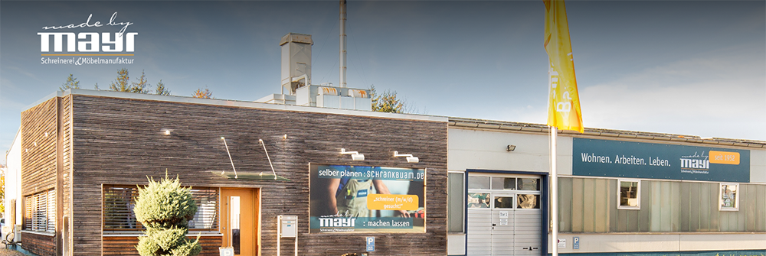
Case studies
Case studies:
Demography-oriented work organization
Company: Schreinerei Ludwig Mayr GmbH & Co. KG, Manching // Carpentry & Furniture Manufactory Mayr
Ludwig Mayr Carpentry promotes a modern, flexible work environment tailored to the diverse life phases of its employees. Flexible working-time models include individually reduced hours to accommodate family, health, or age-related needs, as well as voluntary, project-based working schedules of up to 6 × 10 hours per week. Overtime is credited to a lifetime working-time account and can be taken as paid time off, supporting long-term work–life balance.
Projects are delivered by age-diverse teams, combining experience and creativity to the benefit of both customers and employees. This approach encourages knowledge sharing, mutual learning, and continuous personal development. Ongoing training and professional qualification are key priorities within the company.
To further strengthen collaboration and dialogue between employees and management, Ludwig Mayr Carpentry established a voluntary employee council (Schreinerrat) in 2015. Through this platform, employees are actively involved in shaping important company decisions, reinforcing a culture of participation and trust.
Source:https://www.stmas.bayern.de/arbeit/aeltere-aw.php#sec1
Notes:
Source:
Eurostat. (2025, March 5). 3.7 million women held managerial positions in 2023. Retrieved from https://ec.europa.eu/eurostat/web/products-eurostat-news/w/edn-20250305-1
Eurostat. (n.d.). Employment and unemployment (Labour Force Survey). Retrieved from https://ec.europa.eu/eurostat/web/lfs/database

Slide 16
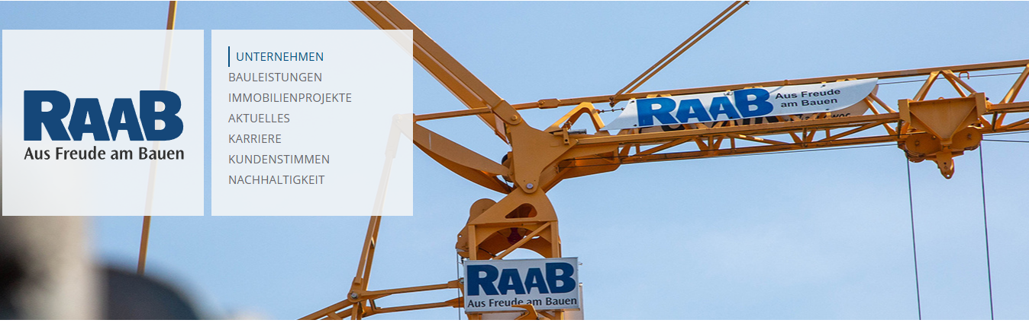
Case studies
Case studies:
Health promotion and management
Company: RAAB Baugesellschaft mbH & Co KG
The company consciously maintains a balanced age structure and actively promotes the long-term employment of experienced employees, both on construction sites and in office roles.
RAAB places great importance on not only recruiting young skilled professionals, but also on creating suitable working conditions for older employees that open up new perspectives. These include part-time models, retraining opportunities, and alternative roles—for example in work preparation or warehouse operations—when the physical demands of construction site work become too strenuous.
Occupational health management plays a key role at RAAB, encompassing back care programs, the use of exoskeletons, targeted health support, and regular occupational safety training.
In addition, the company offers retirees the opportunity to remain actively involved in the business through midijob arrangements, allowing them to continue contributing their expertise and experience.
Source: https://www.stmas.bayern.de/arbeit/aeltere-aw.php#sec1
Notes:
Source:
Eurostat. (2025, March 5). 3.7 million women held managerial positions in 2023. Retrieved from https://ec.europa.eu/eurostat/web/products-eurostat-news/w/edn-20250305-1
Eurostat. (n.d.). Employment and unemployment (Labour Force Survey). Retrieved from https://ec.europa.eu/eurostat/web/lfs/database

Slide 17
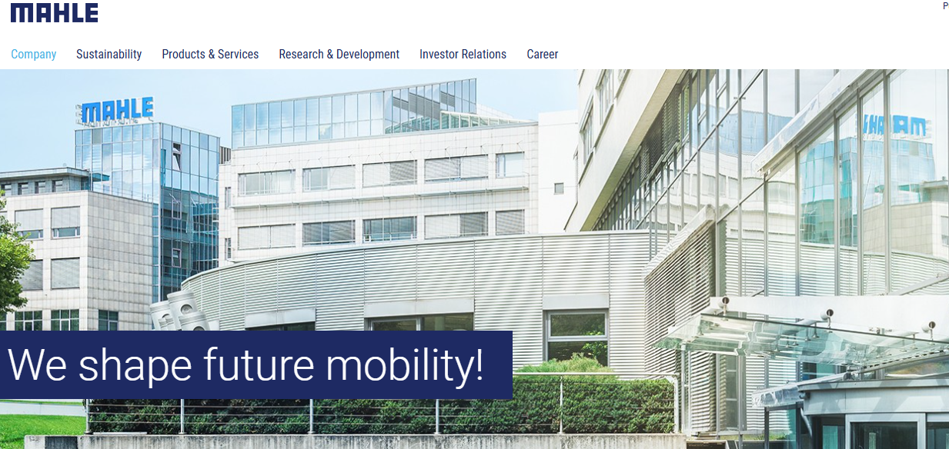
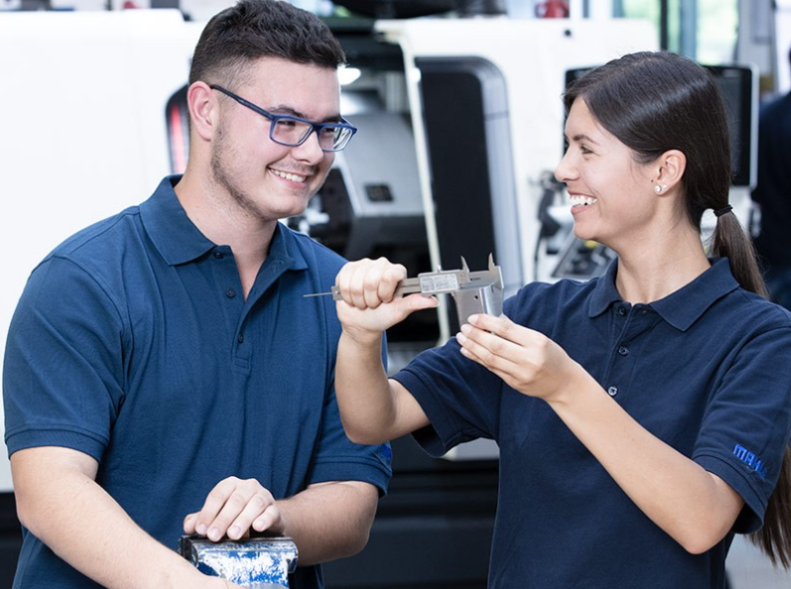
Case studies
Case studies:
Vocational training and lifelong learning
Company: MAHLE
MAHLE is a leading international development partner and supplier to the automotive industry with customers in both passenger car and commercial vehicle sectors.
MAHLE shared drive is the development of innovative technologies for the mobility of today and tomorrow. This pioneering spirit is largely driven by our employees in the company: It is the people behind electric motors, fuel cells, etc. who take our technologies to the next level.
MAHLE offers its employees an extensive learning landscape, for the most part digital. The trainings are largely available on demand; fixed dates and location restrictions are hardly necessary anymore.
This means that learning can take place at any time, at the employee's own pace, according to their needs and from any location, allowing the company to respond to their individual qualification requirements in the best possible way. By using international learning platforms, such as LinkedIn Learning or Coursera, we ensure access to up-to-date content at all times. This makes learning independent of time and place.
Within five months, around 60 employees from production—including older employees aged 57 and above—received further training in various subject areas. After successfully completing the qualification programs, employees are well prepared for their new tasks in a changing world of work. Vocational training and professional development are a key pillar of skilled labor retention at MAHLE Behr GmbH & Co. KG.
Source: https://www.stmas.bayern.de/arbeit/aeltere-aw.php#sec1
Notes:
Source:
Eurostat. (2025, March 5). 3.7 million women held managerial positions in 2023. Retrieved from https://ec.europa.eu/eurostat/web/products-eurostat-news/w/edn-20250305-1
Eurostat. (n.d.). Employment and unemployment (Labour Force Survey). Retrieved from https://ec.europa.eu/eurostat/web/lfs/database

Slide 18
From Challenges to Solutions
Moving from Challenges to Solutions
Given your focus on sustainability and risk management, you might consider how later retirements could help with knowledge retention and reduce turnover costs.
Offering flexible work arrangements to accommodate older employees could allow them to continue contributing without overburdening themselves, improving both their work-life balance and long-term engagement.
Support lifelong learning and reskilling opportunities - Adapting to Technological Changes
Supportive public policy (incentives, grants, training subsidies)
Key Message:
Senior workforce can be a strategic component of a broader response to skills shortages !
Notes:
Source: Eurostat (n.d.). Employment and unemployment (Labour Force Survey). Retrieved from https://ec.europa.eu/eurostat/web/lfs/database

Slide 19

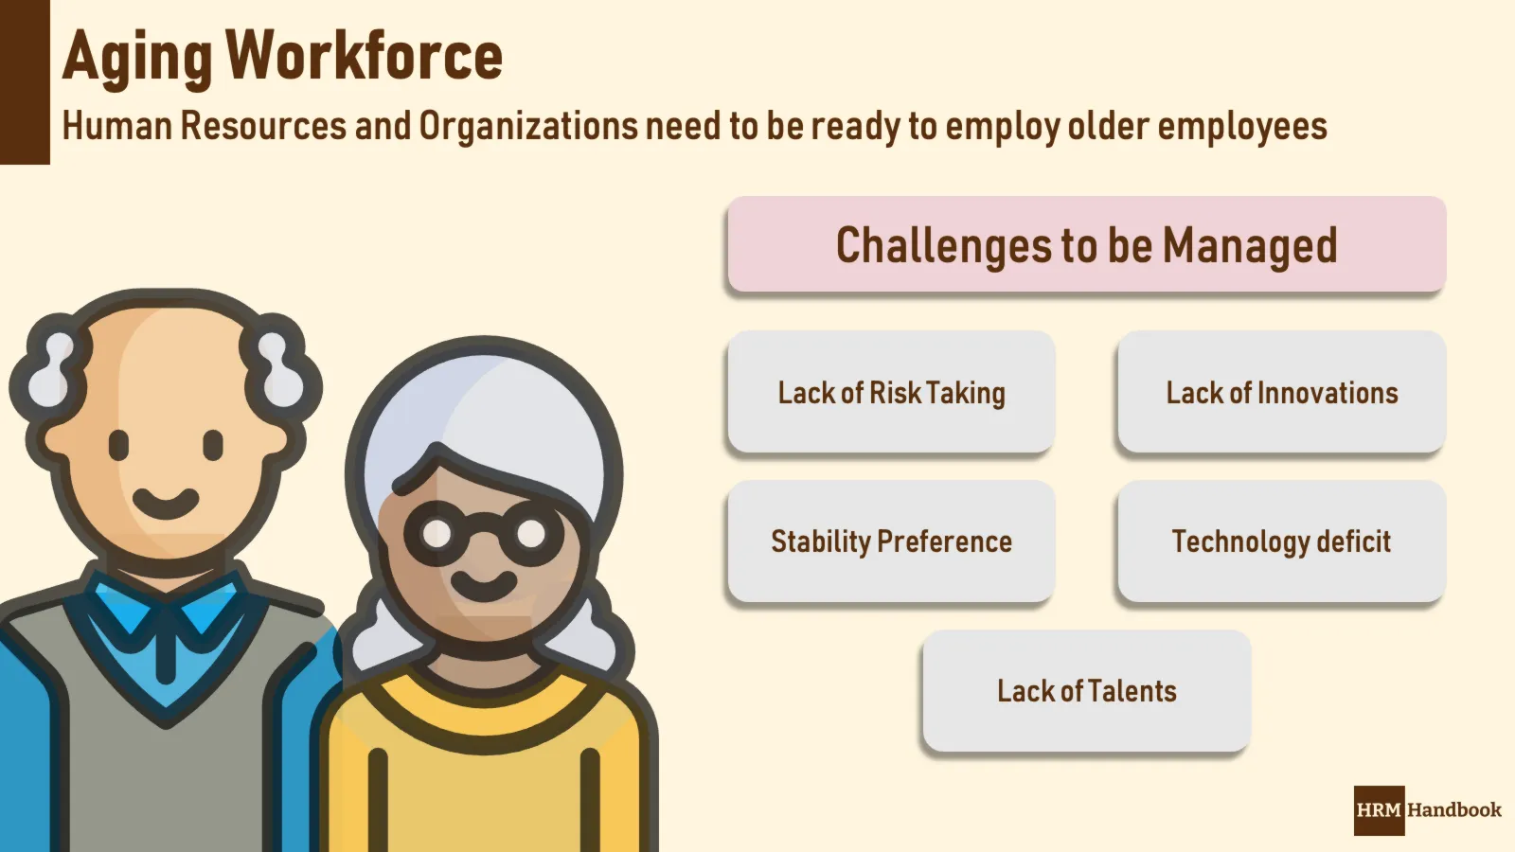
From Challenges to Solutions
Age-Friendly HR Checklist for SMEs
💡 Insight:
Here is a practical, SME-friendly checklist you can use to implement age-friendly HR practices that help tap senior workers’ potential and reduce skills shortages in Europe.
.
Checklist

Slide 20
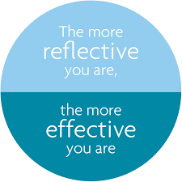
Closing the Session
Reflect and Take Away
Invite short group reflections on which practices could fit their own context. (Presentation & Q&A)
Interactive Exercise:
“Designing an Age-Inclusive HR Policy” (10 Min)
Small groups: review a scenario (e.g., redesigning a learning & development program to include senior staff).
Work with the ELEVATE Checklist
Identify concrete HR measures, incentives, and leadership supports. (Group discussion & feedback)
Leadership Approaches Summary (5 Min)
Summarize leadership styles that support senior workers:
Intergenerational teams
Lifelong learning and reskilling opportunities
Coaching & mentoring cultures
Inclusive communication strategies.
Connect these to HR’s role in leader development. (Presentation)
…
Reflection & Takeaway
Roundtable question: “What’s one HR initiative you could implement in your company to leverage senior talent?”
Summarize and close. (Group reflection)
Message: Reflection turns insights into action.
.
Notes:
Source: United Nations Global Compact. (2024). Starlight Media: Internal and external gender equality actions. Retrieved from https://unglobalcompact.org/take-action/target-gender-equality/interviews-with-female-leaders/starlight-media

Slide 21
THANK YOU

